Slide 1
Mission Report in National Taiwan University, Taipei
Mark 10:45 says,
“For even the Son of Man did not come to be served, but to serve, and to give his life as a ransom for many.”

Slide 2
Midlife Crisis
God gives me vision to become professor shepherd in 2005.
I work as a postdoctoral fellow in Academia Sinica, so that I have free time every Saturday and prepare Sunday message.
But in January this year, my boss advised me to find a new job.
I was trapped in midlife crisis
I complained about long postdoctoral period without job promotion and hardship in raising disciple.

Slide 3
God’s Great hope
While I wrote the testimony, I received Mark 10:45, “For even the Son of Man did not come to be served, but to serve, and to give his life as a ransom for many.”
Jesus loves me, and scarifies his own life to give me life.
God has a great hope on me and bless me a great nation and a blessing.
God is training me to be humble, so that I can understand others and comfort others with God’s words.

Slide 4
Serving new bible students
I accept God’s hope on me.
I repent of my unbelief and self-righteousness, and became thankful to God’s leading.
I learn serving others first, instead of attaining human glory and satisfying my own dream and desire.
I invite my colleague in the same laboratory for bible study.

Slide 5
1-to-1 bible ministry
We have a new heart and go fishing in the campus.
God gave us many new sheep.
For instance, a Vietnamese postdoctoral fellow in my laboratory study bible with me. He has never heard the story about Jesus before, and he is humble to God’s words.
Later (in December) my laboratory supervisor encouraged me to invite my colleague with depression problem to my church.
Although I do not see great fruit immediately, I find that God is using me as a source of blessing in my laboratory and the NTU campus.

Slide 6
Hardship in ministry
But, my faithful sheep Brother Chuang has tempted by the world and his lustful desire (Roman Chapter 1:27), and become unstable.
Recently our city has elected for a new Mayor who supports the gay marriage, and his policy will favor the homosexuality.
We pray that Brother Chuang stands firm against the worldly temptation.
We also pray that the Taiwan government keeps the heterosexual marriage, and does not adopt gay marriage.

Slide 7
Growing Disciple
One graduate sister, who shared common life with us for 6 months, left our ministry.
However, God brought a faithful sister, Jenny, from Kaohsiung. Now she leads the singalong during the Sunday worship.
Recently she is admitted to a part-time PhD in National Taiwan Normal University.
We pray that Sister Jenny has vision to serve campus wandering souls.

Slide 8
Renewal of Vision
By God’s grace, in July, God moved my supervisor to renew my appointment.
In November, I won the best article award in a local journal.
My vision to become a professor shepherd is renewed.
I decide to be a professor shepherd, who not only teaches students with scientific truth, but also demonstrates that Jesus is the Truth and Life.

Slide 9
Sunday worship service in 2014
We have studied Genesis and Romans this year, and have 4 stable Sunday Worship attendants.
One sheep Brother Li graduates with a master’s degree and move to work in Shanghai, China. He attends our Sunday service faithfully by using Skype.
A Mongolian shepherdess Sarnei studies in the central part of Taiwan and attends our Sunday service once a month.

Slide 10
Bible Conferences in 2014
New Year Bible conference (25/1-26/1)
We book a conference site far away from university.
Missionary Mark and Gloria joined this conference.
Missionary Gloria delivered the message according to Daniel Chapter 3, while Mark delivered the message according to Daniel 6.
We are renewing with pioneering spirit to invite new students for bible study.

Slide 11
Easter Bible Conference (4/19-4/20)
Our bible conference was held in a classroom in our university.
So, we could invite new students to the conference.
Sister Jenny from Kaohsiung who just joined our chapter delivered a message entitled ‘My God, my God, why have you forsaken me?’
Also, Mongolian Shepherdess Sarnei delivered a biography of George Leslie Mackay. He was the first missionary in the Northern Part of Taiwan in the 19th century.
We received a lot of encouragement and great vision from his mission life.
‘My God, my God,
why have you forsaken me?’

Slide 12
Summer bible conference (7/26-27)
Sister Jenny and his ex-student played the music of the sing-along which supported the conference gracefully.
Missionary Mark prepared Luke Ch.15, “Father’s love,” and also invited his colleague for the conference.
Sister Jenny prepared an evening message on Mark Ch2.
A bible student, Gin Liu, shared life testimony about his lustful desire. Now he is in US and has bible study through Skype.
We pray that Gin Liu to receive the baptism of Holy Spirit and repent of his sins.
Finally, Missionary Gloria prepared John Ch8, “The truth will set you free.”
10 people joined.
“The truth will set you free.”

Slide 13
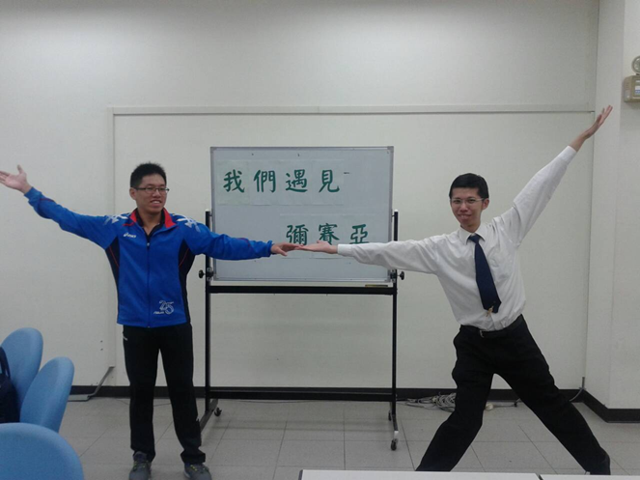
Autumn bible conference (10/18-19)
Msn Mark delivered Mark 8. The central theme is “We have found the Messiah.”
Missionary Mark delivered the message of John Chapter 1.
Sister Jenny delivered the message of John Chapter 2, ‘Jesus Changed water to wine’.
Jenny was busy before the conference, because she was applying a PhD program. But, she sought his kingdom first and prepared a graceful message.
Msn Gloria delivered John Ch4, ‘Jesus is the living water’. 5 people joined.
“We have found the Messiah.”

Slide 14
Christmas Sunday service (12/21)
Glory from Baby Jesus in manger
This special Sunday service began with a short video entitled, “The Greatest Gift,” which opened our hearts to receive Baby Jesus.
Mongolian Shepherdess Sarnai sang a special song, “Mary, Did you know?”
Missionary Mark Hui delivered the Christmas message based on Luke Ch2.
We saw the glory of Baby Jesus in the manger and were moved by Jesus humility.
Finally, Sister Jenny delivered her life testimony. She remembered God's grace changing her life. 6 people joined this worship.

Slide 15
Baby Bible Fellowship
Evening Sunday service
Paul (5-year-old) and Grace (3-year-old) attends our compulsory Sunday service.
25-minute Sing-spiration.
5-minute Sunday message.
1-minute prayer.

Slide 16
Vision and Prayer topics in 2015
Last year we received much grace.
At the same time we faced many hardships, especially the hardship in raising disciples.
Sometimes we lost heart to fight a good fight.
We pray to fix our eyes on Jesus and his eternal glory and take up the cross.
We choose our New Year Key Verse as Hebrews 12:2 says, “fixing our eyes on Jesus, the pioneer and perfecter of faith. For the joy set before him he endured the cross, scorning its shame, and sat down at the right hand of the throne of God.”

Slide 17
Prayer Topics for Taipei ministry
1.Missionary Mark Hui’s powerful Sunday message with 5000 Chinese characters.
2. To raise Missionary Mark as a professor shepherd.
3. To establish Abraham of Faith and Sarah.
4. To raise up 12 Sunday worshippers.
5. To have 16 pairs of one-to-one bible study.
One word: Fix my eyes on Jesus, endure hardship for him and experience his resurrecting power.
Thank you.

