Slide 1
LET US FIX OUR EYES ON JESUS Hebrews 12:1-29
2016 New Year’s Message
Pastor Abraham Kim

Slide 2
Key Verses: Heb 12:1b-2
“And let us run with perseverance the race marked out for us, fixing our eyes on Jesus, the pioneer and perfecter of faith. For the joy set before him he endured the cross, scorning its shame, and sat down at the right hand of the throne of God.”

Slide 3
“Our days… quickly pass, and
we fly away”
(Ps 90:10)

Slide 4
I. We Are Running A Race (1)

Slide 5
“Therefore, since we are surrounded by such a great cloud of witnesses, …. let us run with perseverance the race marked out for us.”
(Verse 1)

Slide 13
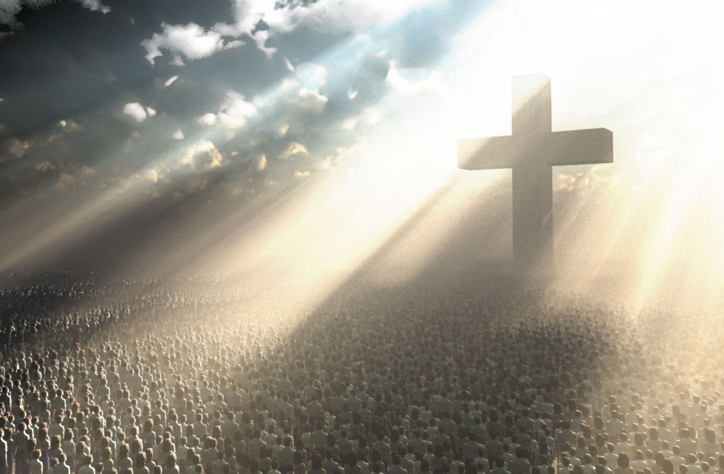

Slide 14
II. Throw Off Every Weight
And Sin
(1b)

Slide 15
“Let us throw off everything that hinders and the sin that so easily entangles.”
(Verse 1b)

Slide 17
“They did not receive the things promised.”
(Heb11:13)

Slide 19
“Put off your old self, which is being corrupted by its deceitful desires.”
(Eph 4:22)

Slide 20
III. Fix Our Eyes On Jesus (2-3)

Slide 21
“…fixing our eyes on Jesus, the pioneer and perfecter of faith. For the joy set before him he endured the cross…”
(2a)

Slide 22
“…fixing our eyes on Jesus, the pioneer and perfecter of faith. For the joy set before him he endured the cross…”
(2a)

Slide 23
“믿음의 주요 또 온전케 하시는 이인 예수를 바라보자. 저는 그 앞에 있는 즐거움을 위하여 십자가를 참으사 …”
(2상)

Slide 24
First,
Jesus is the Pioneer and
Perfecter of our faith.

Slide 25
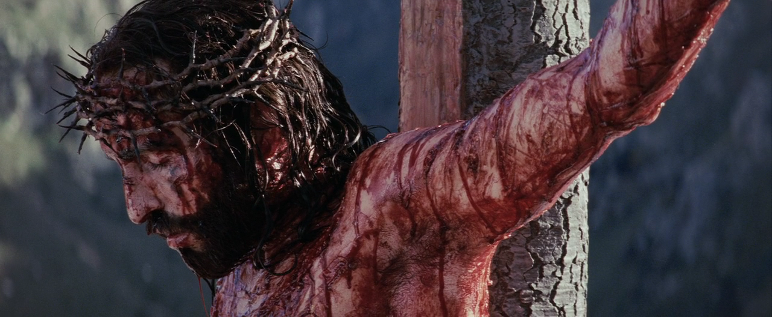
“It is finished.” (Jn 19:30)

Slide 27
Second,
Jesus is the Way to
supreme glory.

Slide 28
“For the joy set before him he endured the cross, scorning its shame, and sat down at the right hand of the throne of God.”
(2b)

Slide 32
“Whoever wants to be my disciple must deny themselves and take up their cross and follow me”
(Mk 8:34)

Slide 34
“Consider him who endured such opposition from sinners, so that you will not grow weary and lose heart.”
(3)

Slide 36
“Surely I am with you always.”
(Mt 28:20)

Slide 37
Charles T. Studd (1860-1931)

Slide 38
The Cambridge Seven called for
China Inland Mission

Slide 39
“If Jesus Christ be God and died for me, then no sacrifice can be too great for me to make for him.” -- Charles T. Studd

Slide 40
“Only one life, yes only one, Now let me say, “Thy will be done”; And when at last I’ll hear the call, I know I’ll say “twas worth it all”; Only one life, ‘twill soon be past, Only what’s done for Christ will last.”
-- Charles T. Studd

Slide 41
IV. Endure Hardships As Discipline From Our Loving Father
(4-29)

Slide 42
“Endure hardship as discipline;
God is treating you as his children.”
(7)

Slide 43
“Without holiness no one will
see the Lord.”
(14b)

Slide 45
“Jesus, Son though he was,
learned obedience through what
he suffered.”
(5:8)

Slide 46
“Therefore, strengthen your feeble arms and weak knees. ‘Make level paths for your feet,’ so that the lame may not be disabled, but rather healed.”
(12-13)

Slide 47
1) All leaders in our ministry continually fix our eyes on Jesus and grow to bear the image of the Good Shepherd Jesus; 2) All leaders raise disciples as Jesus raised his disciples by showing them his own example and teaching them God’s word of truth;
3) God sends out thousands of missionaries, both young and old, from UBF worldwide to the ends of the earth.

Slide 48
“All that is not eternal is
eternally out of date (useless).”
-- C. S. Lewis

Slide 49
Three Things that are Eternal
Christ-like character (Mt 5:5,9)
What we have given to God (Mt
6:20)
People who have been saved
through our ministries (Php 4:1)

Slide 50
LET US FIX OUR EYES ON JESUS Hebrews 12:1-29

