Slide 1
JAKARTA INDONESIA UBF MISSION REPORT 2014 The third time he said to him, “Simon son of John, do you love me?” Peter was hurt because Jesus asked him the third time, “Do you love me?” He said, “Lord, you know all things; you know that I love you.” Jesus said, “Feed my sheep. (John 21:17)

Slide 2
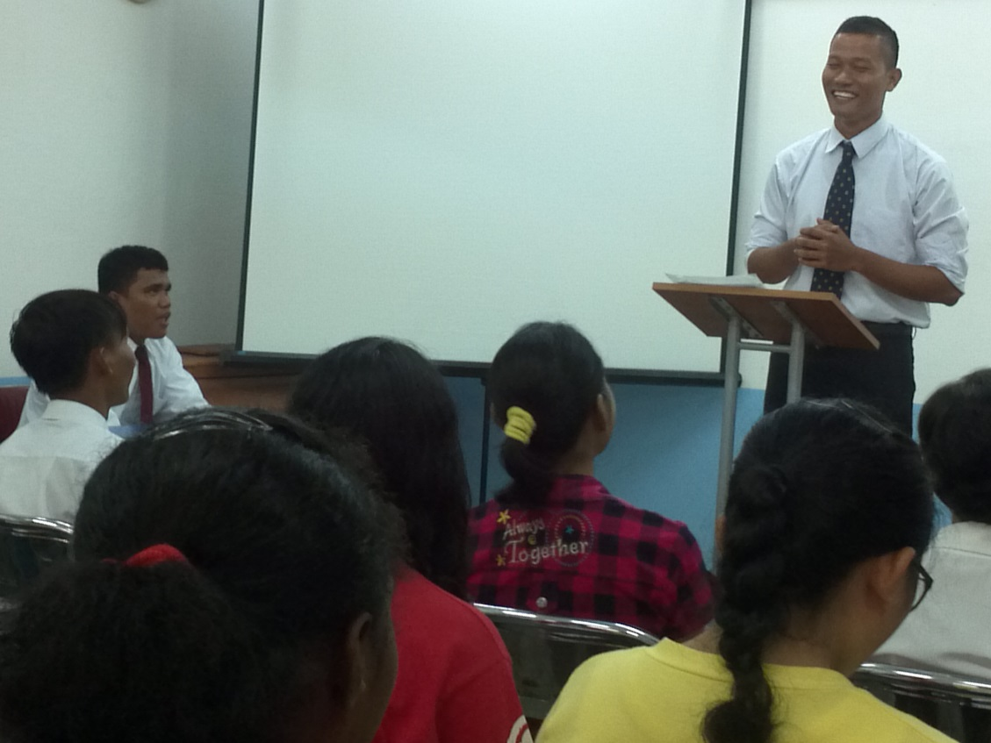
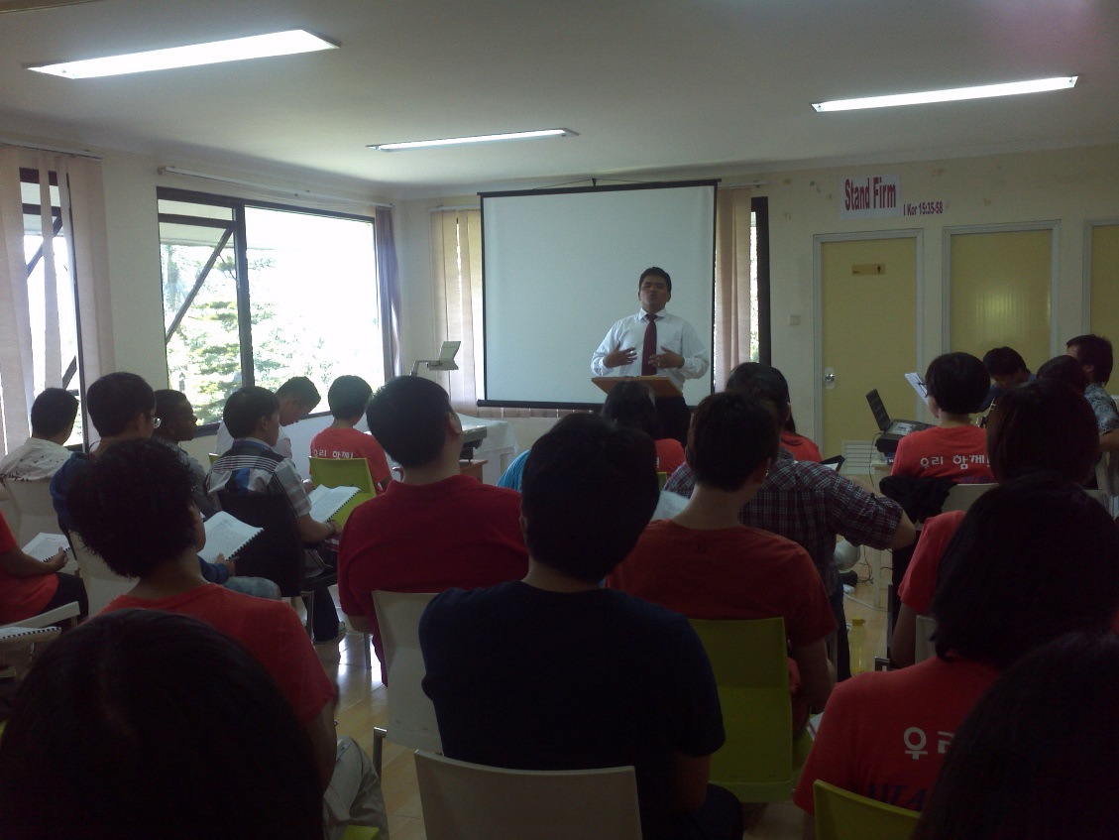
Ministry of the Word
Studying the book of Hosea and Romans
Messengers
Upon acknowledgement of God and His grace (Hosea 6:6; Rom 6:14)

Slide 3
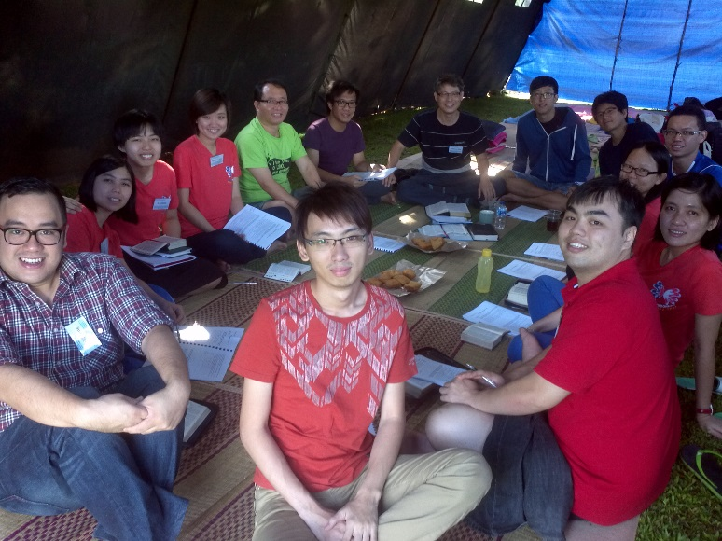
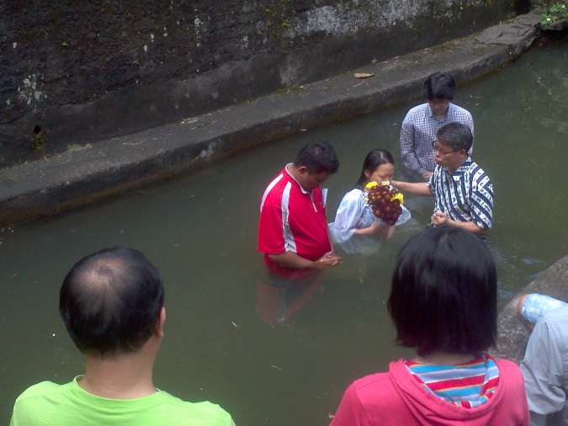
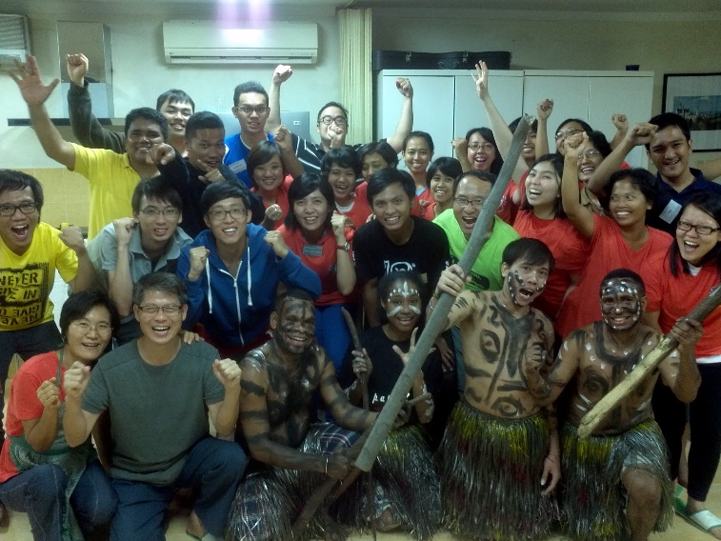
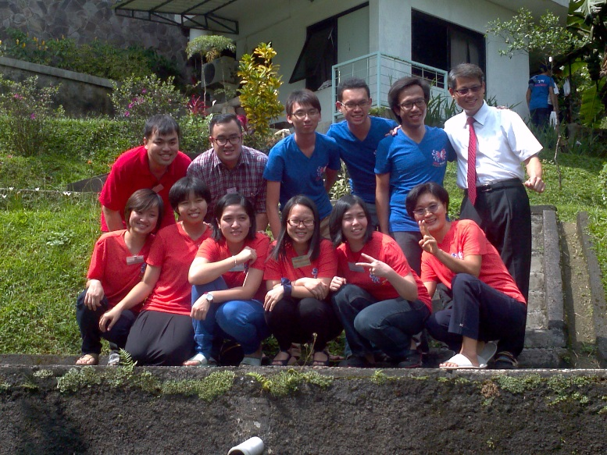
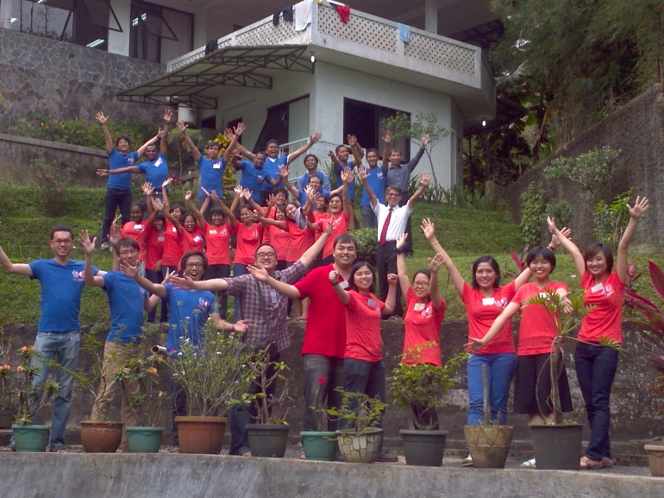
Ministry of Easter Conference
31 attendees
8 Malaysia UBF brothers and sisters join
Rented a large military tent
Korean and Indonesian food
Easter 3 main messengers
Special program
Baptism
SEAM

Slide 4
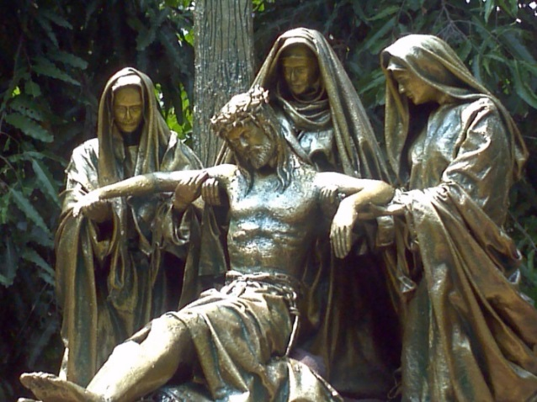
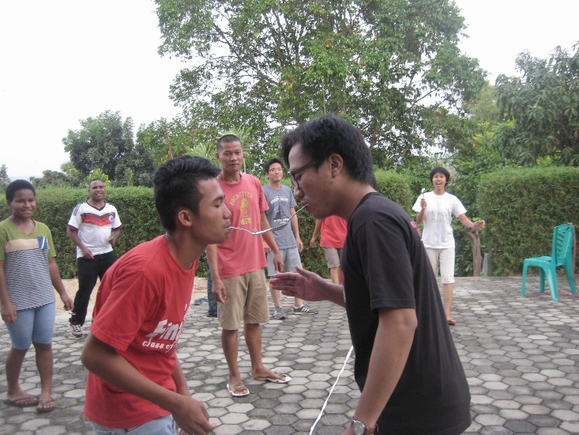
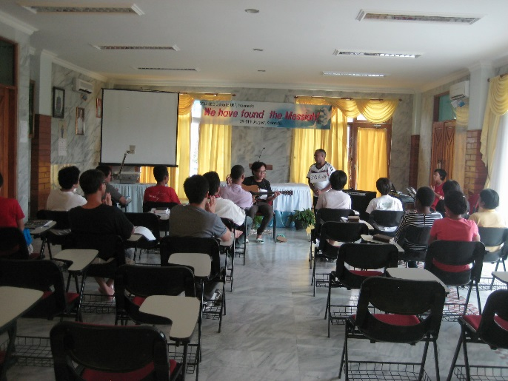
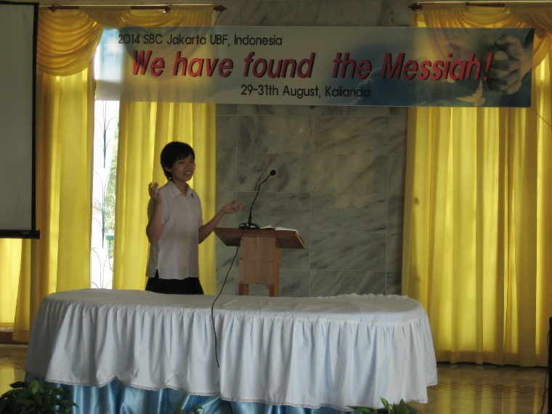
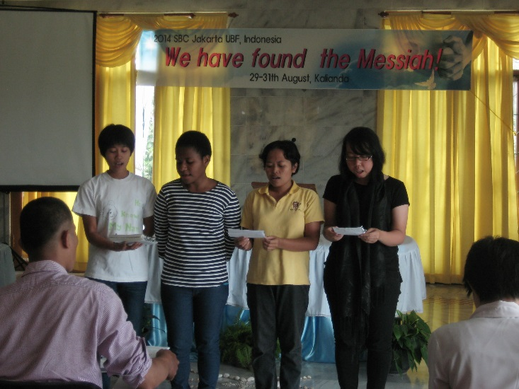
Ministry of Summer Bible Conference
During Lebaran (Ramadhan) from Aug. 29th to 31st
Atended by 18 people
Sister Act
Statues (viadolorosa)
Aerobics
The beach
Hot well springs
All messengers memorized their script fully

Slide 5
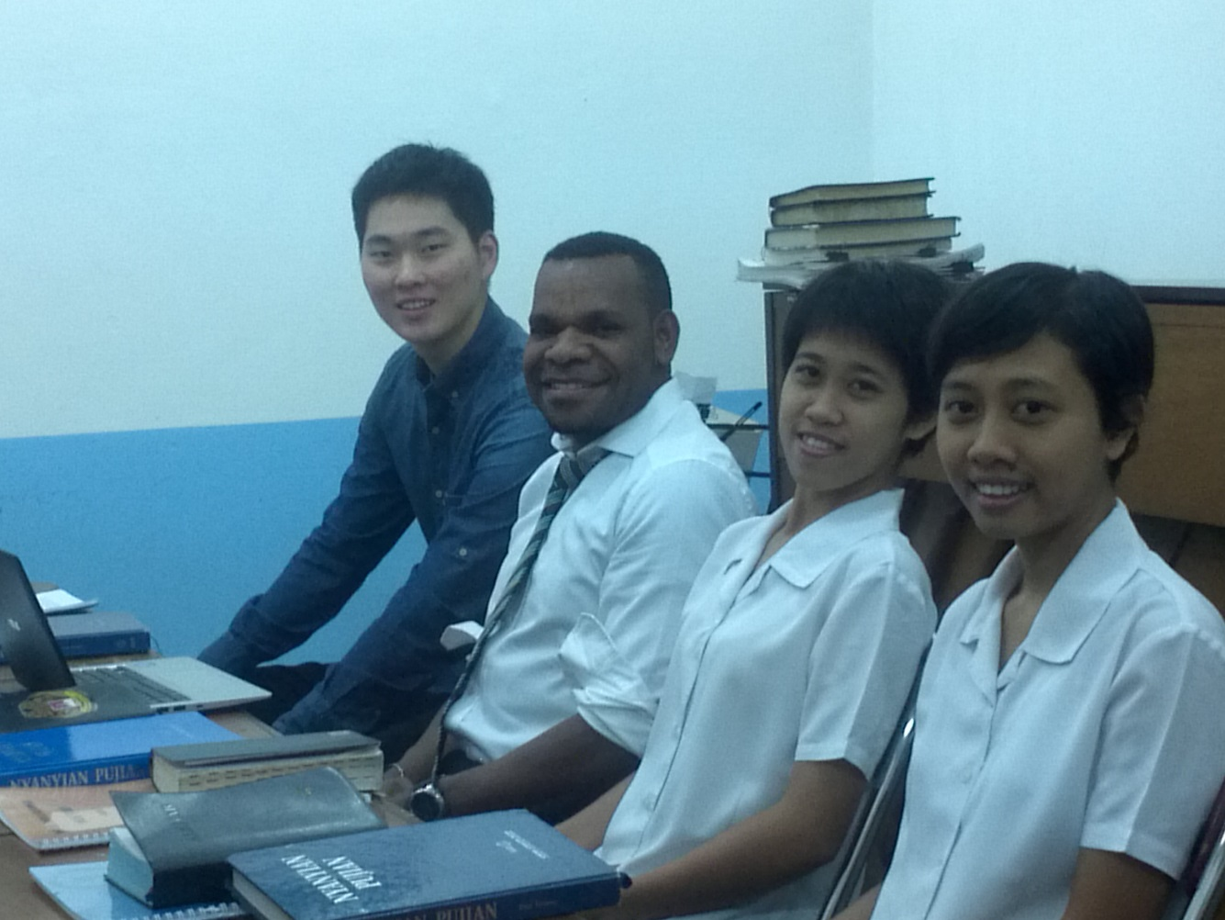
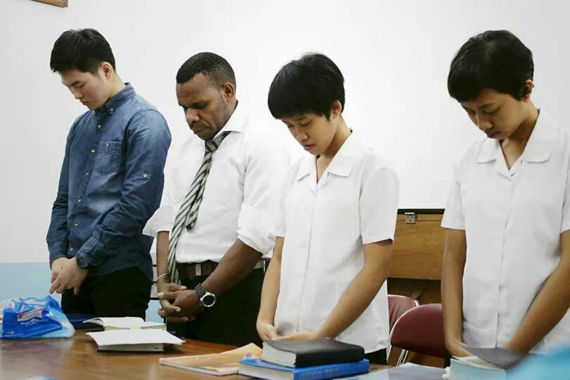
Raising Shepherds
3 Shepherds and 2 candidate shepherds

Slide 6
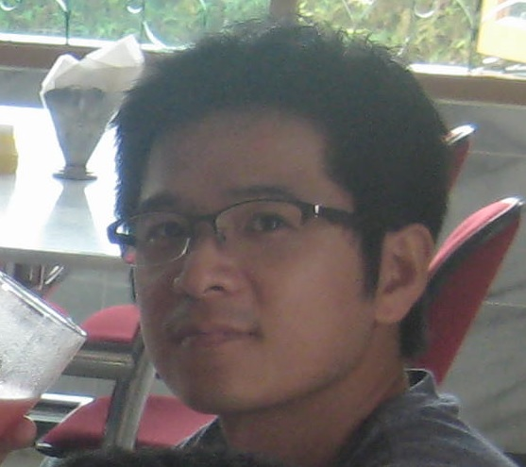
History of Life (new co-workers)
Sh. Geun-Hong Kim (Yeon Hee UBF, Korea)

Slide 7
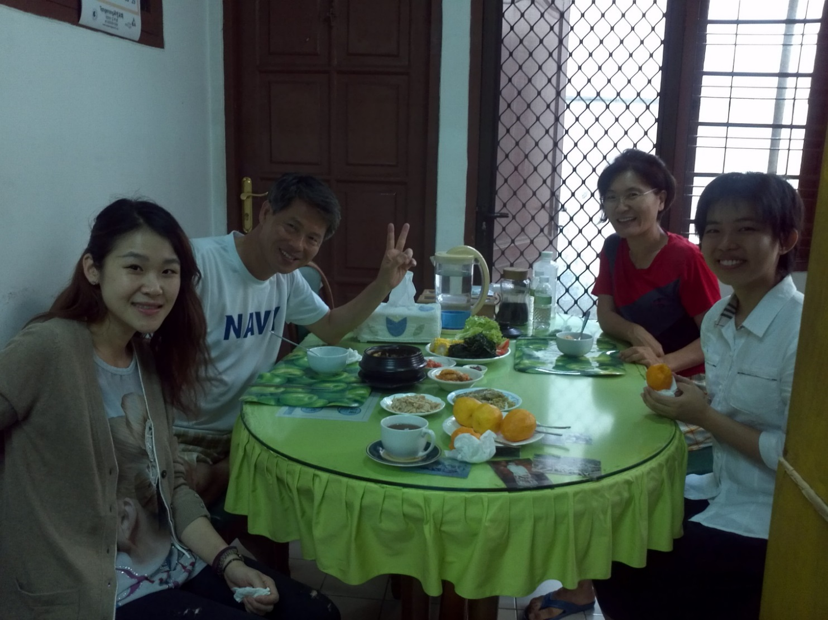
History of Life (new co-workers)
Sis. Jenny (Kaoshiung UBF, Taiwan)

Slide 8
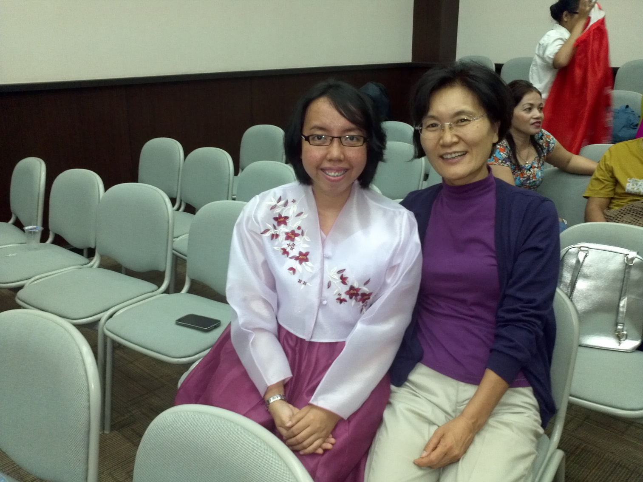
History of Life (new co-workers)
Sis. Marito (Atmajaya Univ.)

Slide 9
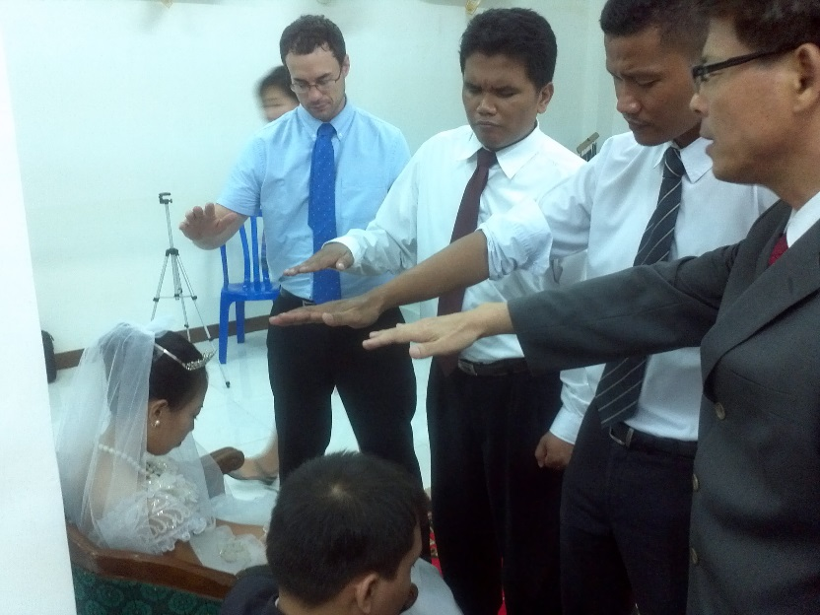
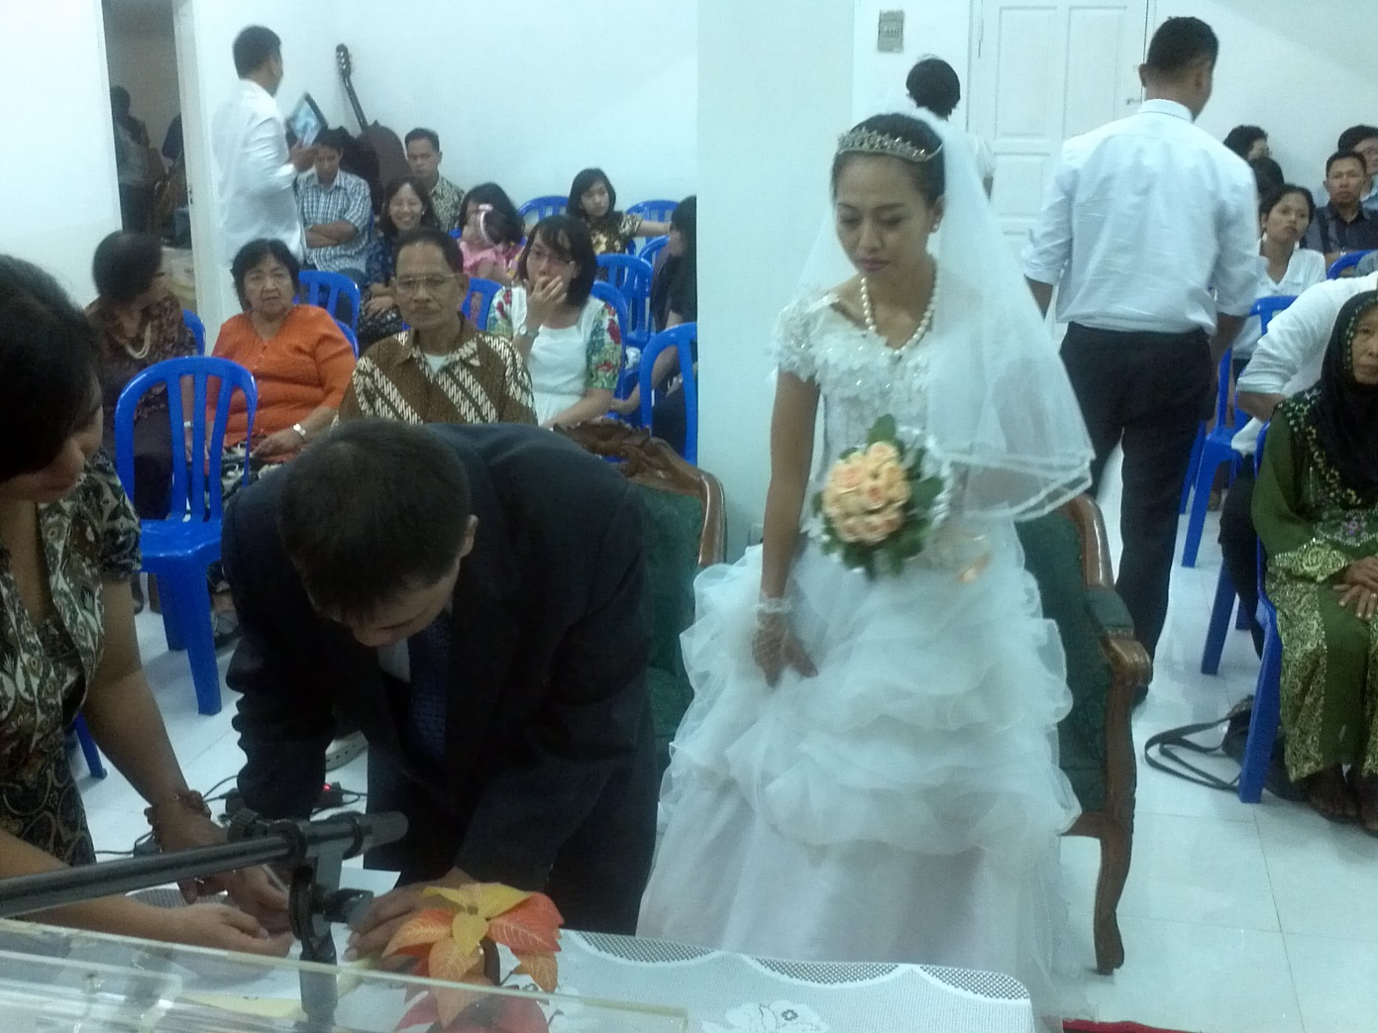
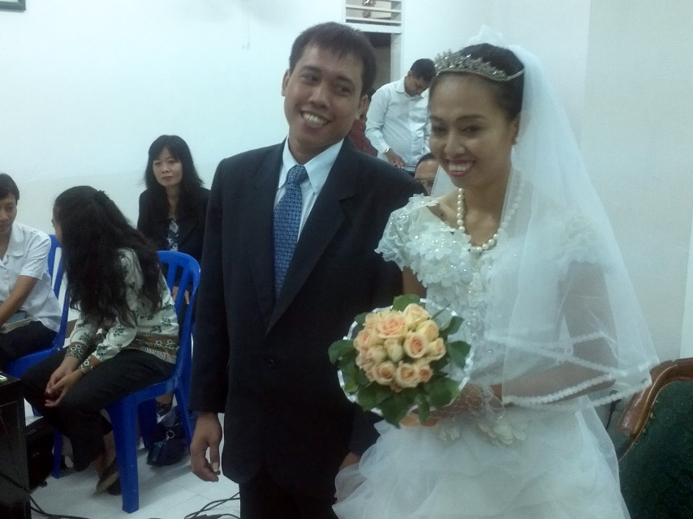
History of Life (new co-workers and birth of house church)
New House Church

Slide 10
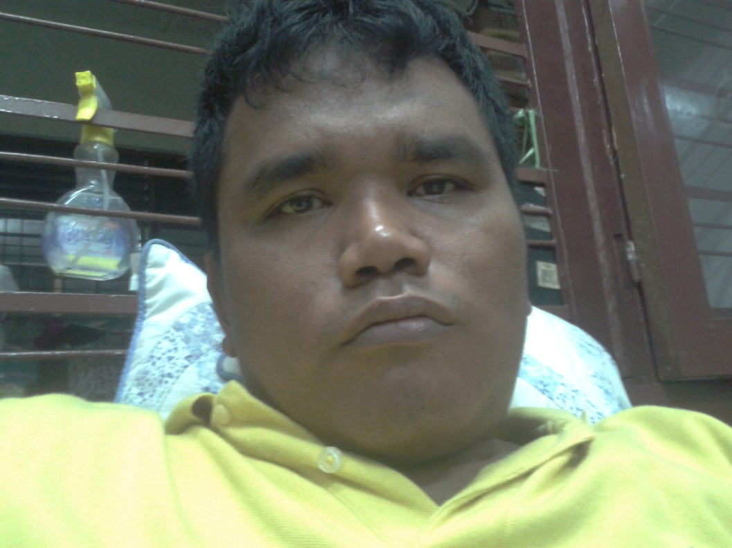
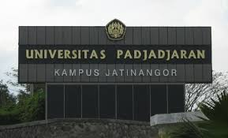
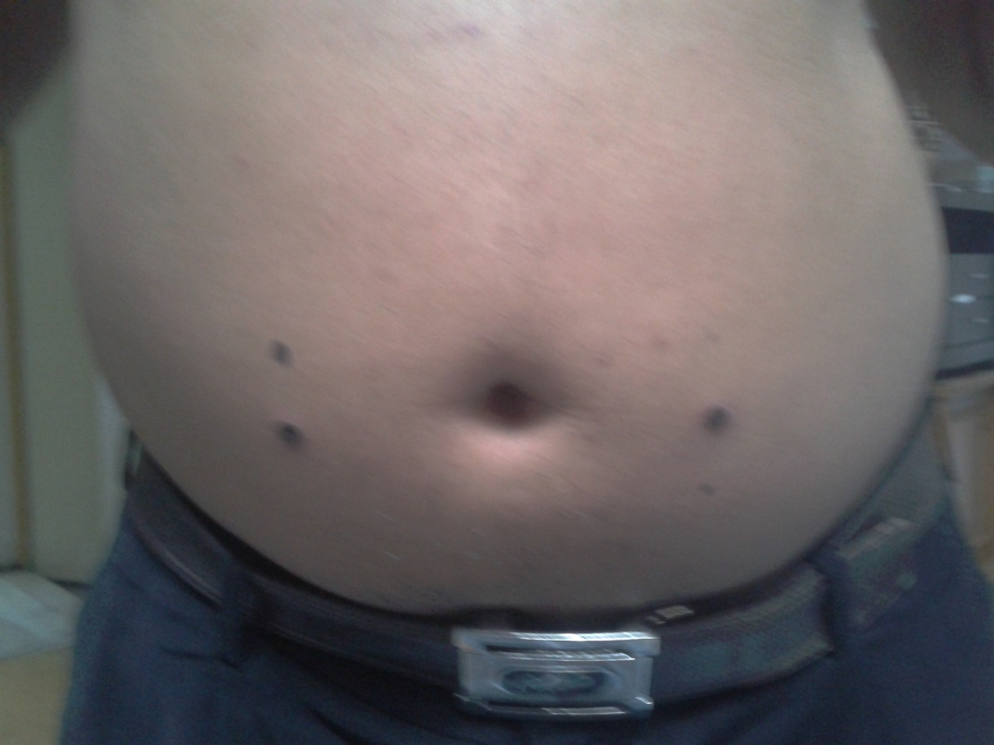
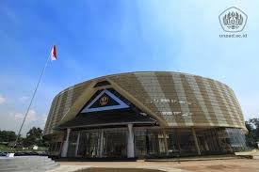
History of Life
God-given New Life to Ancestral Shepherd Hengky
-His Remaining 6 months of his life

Slide 11
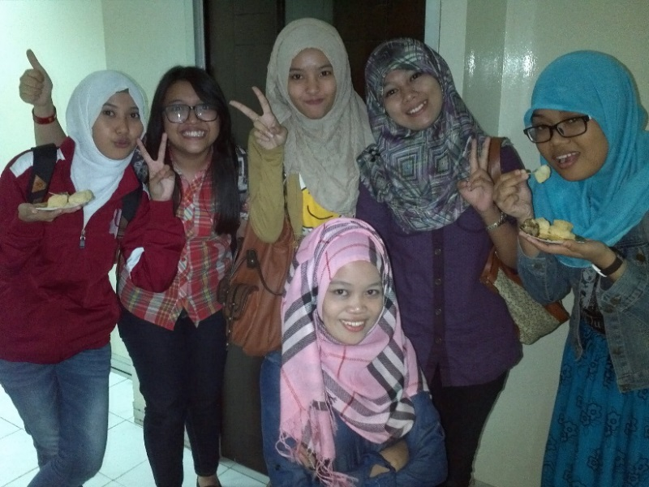
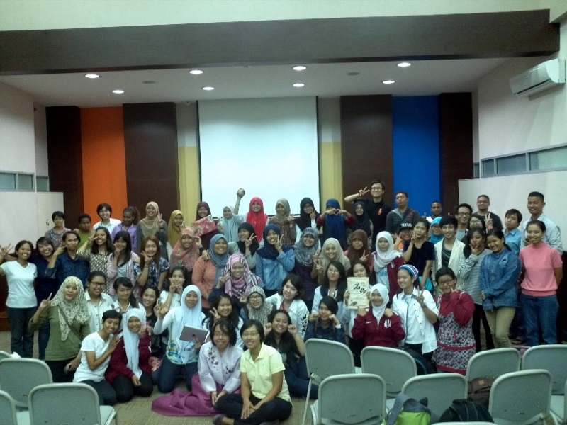
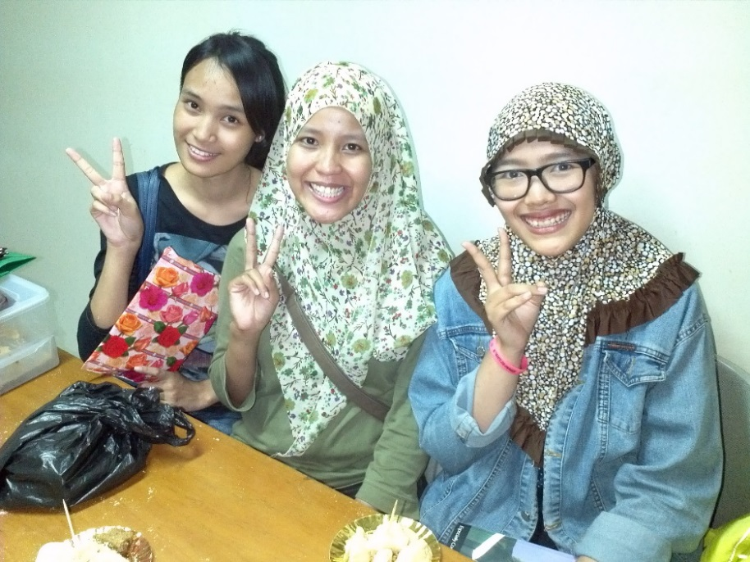
Ministry for 2014 Freshmen
Freshmen Welcome Party

Slide 12
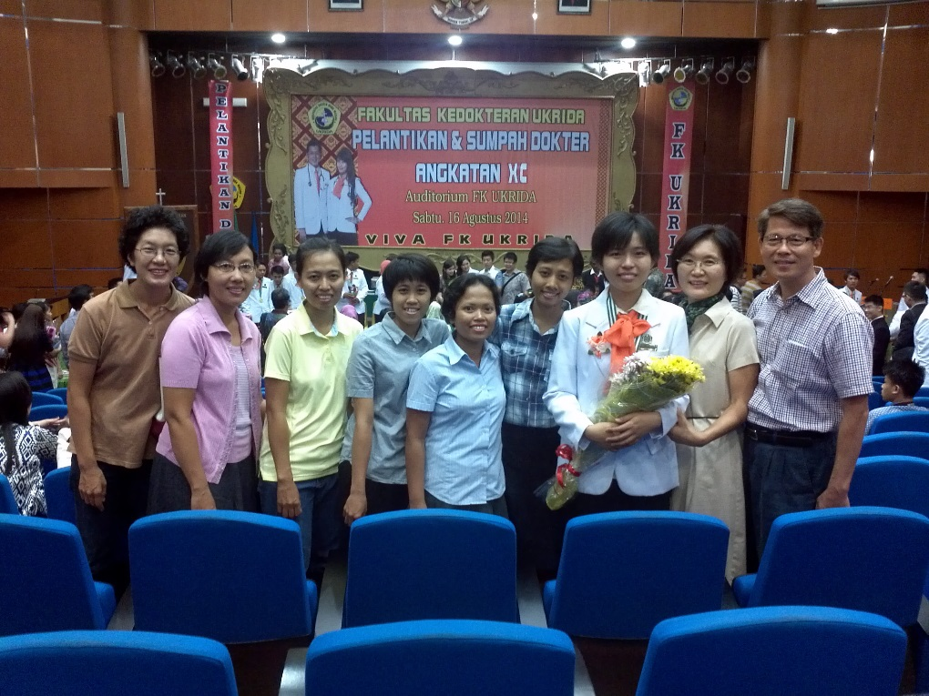
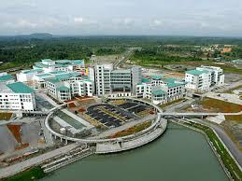
History of Life (new co-workers)
Opened door to pioneering East Malaysia
UNIMAS (Univ. Malaysia Sarawak)

Slide 13
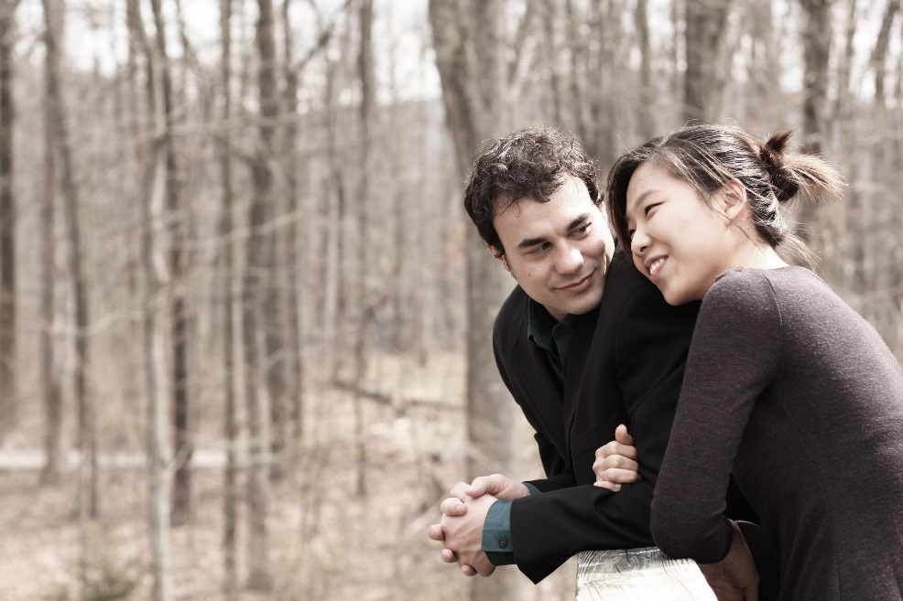
History of Life (new co-workers)
Chris Shepherd home (Shippensburg UBF, USA)
-Assist ministry of Jakarta UBF and Ministry of East Malaysia

Slide 14
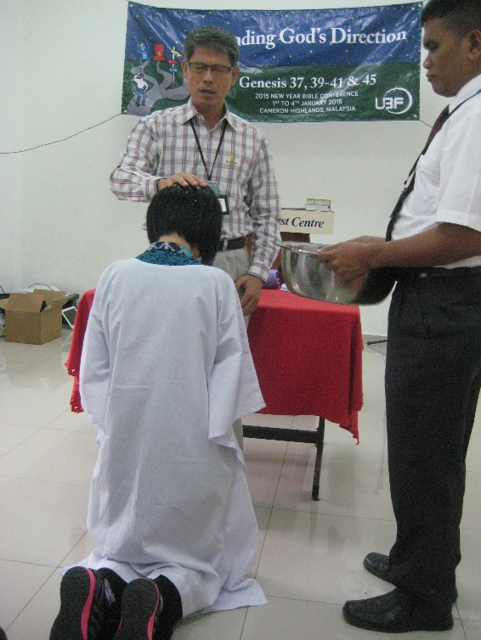
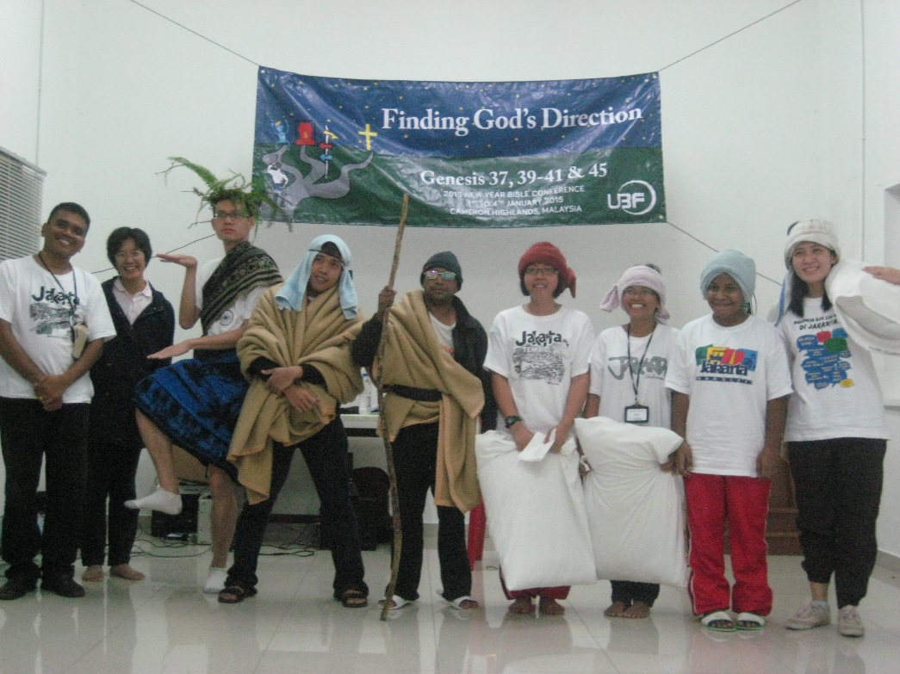
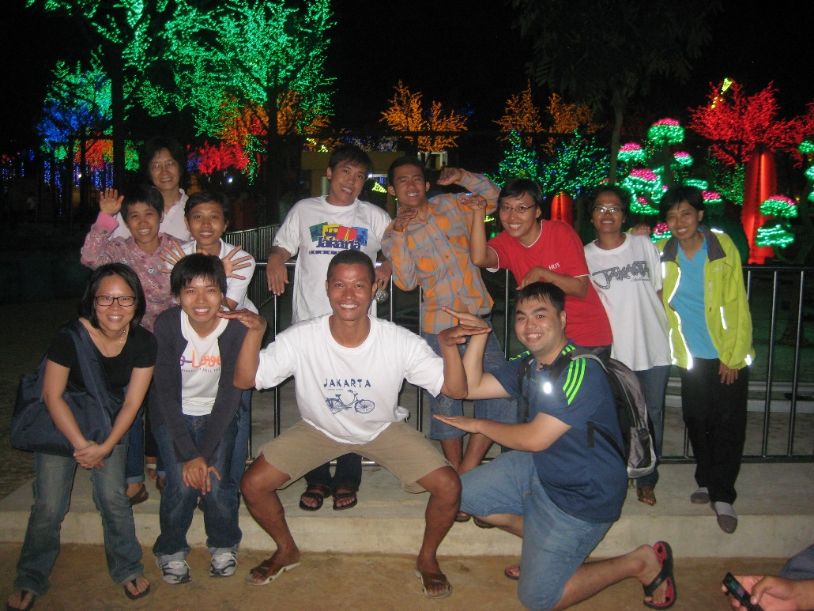
History of Coworking
Co-working with Malaysia K.L. UBF (New Year Conf.)

Slide 15
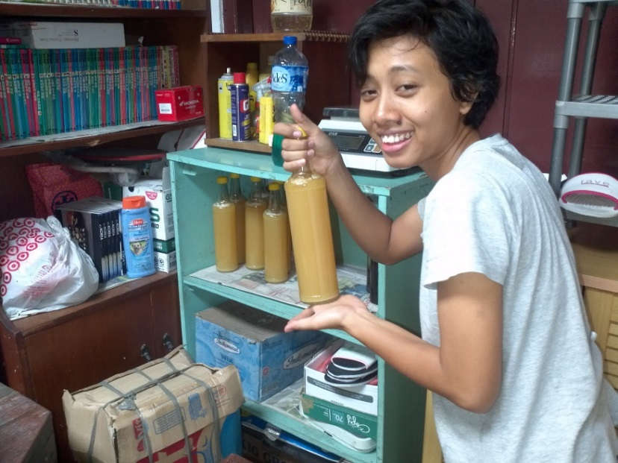
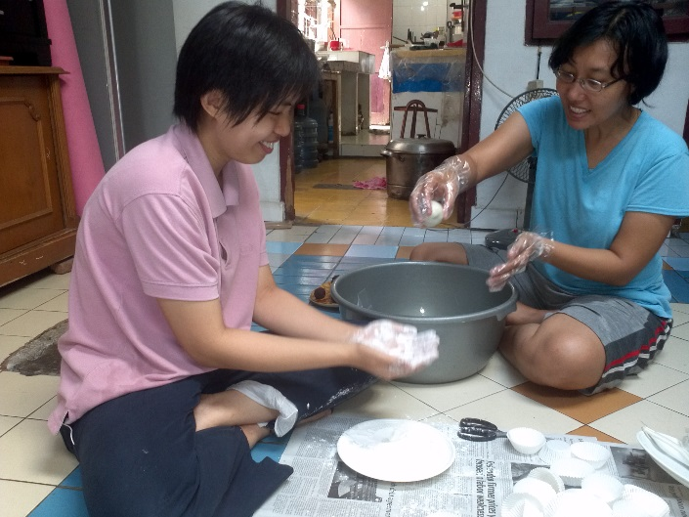
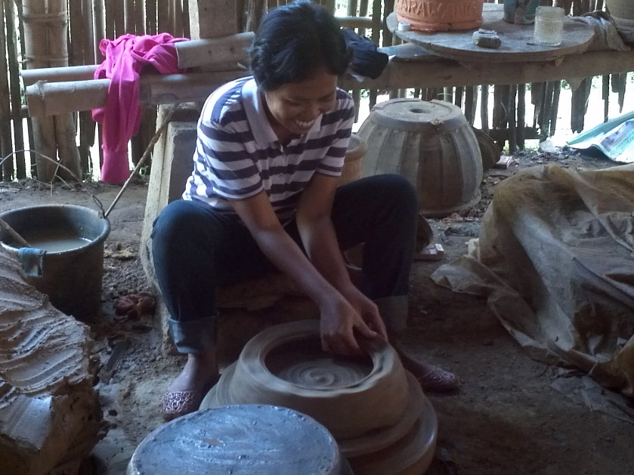
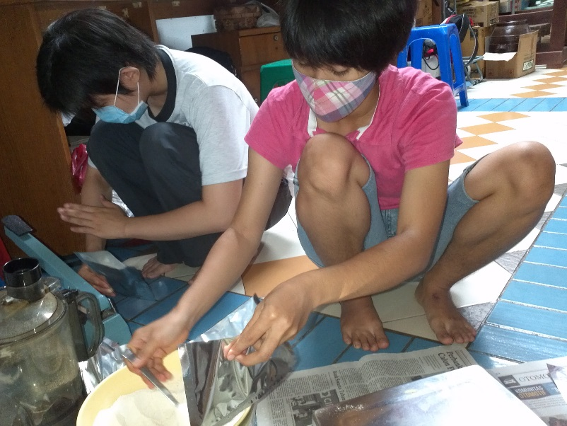
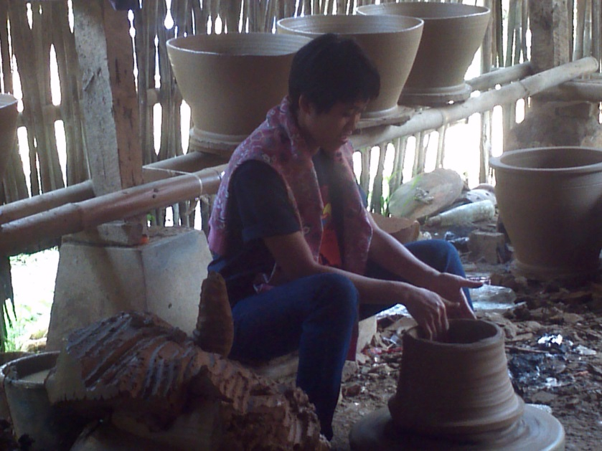
Thanksgiving Topics
Thanksgiving Topics
Fulfilling the ministry of Romans Bible study
Expand From 7 campuses to 10 campuses
Cowork well with native shepherds
To have an independent economic life

Slide 16
New Year 2015 Direction
Key Verse of Jakarta UBF : John 21:17
(1) pray that we may be more spiritually awake by struggling to eat daily bread and prayer consistently
(2) pray that there may be movement in our one-to-one ministry
(3) pray that we may have 2 pioneered Chapters
(4) pray that the shepherds are able to study acupuncture with faith and commitment
Key Verse :
1. M Peter Kim-Rom 12:1,2
2. Sh Hengky-Mat 6:33
3. Sh Carolus-1 Ki 2:2,3

