Slide 1
Malaysia Manila UBF Bible Conference
May 27-28, 2016
In the Philippines.

Slide 2
Pray for my trip: May 5-June 7, 2016
I’ve visited Manila yearly since 2002.
The verse that touches my heart during every visit to the Philippines is John 3:8.
“The wind blows wherever it pleases. You hear its sound, but you cannot tell where it comes from or where it is going. So it is with everyone born of the Spirit.”
I love the Philippines…I always feel the wind blowing.

Slide 4
“My Eyes Have Seen the King” (Isaiah 6:5)
“Woe to me!” I cried. “I am ruined! For I am a man of unclean lips … and my eyes have seen the King, the Lord Almighty” (Isa 6:5).

Slide 5
Isaiah in Four Bible studies
Isaiah 1 (The problem): What’s the problem?
Isaiah 6 (The solution): What’s the solution?
Isaiah 7 (The challenge): What’s the challenge?
Isaiah 9 (The child): Who is the one you trust?

Slide 6
Isaiah 1, 6, 7, 9
2016 Isaiah conference (Four sermons/lectures):
Isaiah 1 (The problem): No calling. No vision.
Dr. John Talavera, Antipolo, Philippines.
Isaiah 6 (The solution): Hear the call. See God.
Jimmon Rubillos, Valenzuela, Philippines.
Isaiah 7 (The challenge): Trust God.
Ison Hong, Kuala Lumpur, Malaysia.
Isaiah 9 (The child): The one you trust.
Vincent Lee, Kuala Lumpur, Malaysia.

Slide 7
Isaiah in a nutshell
Chapters | 1-39 | 40-55 | 56-66
Context | Assyrian invasion | Babylonian exile | Return from exile
Addressing | Pride Rebellion | Despair Hopelessness | Helplessness Weakness
God | King | Servant | Conqueror
Status | Unrighteousness | Righteousness | Righteous living
Tone/Thrust | Conviction Confrontation | Comfort Consolation | Character Conquest
Theme | Trust | Grace | Power

Slide 8
Malaysia UBF in Kuala Lumpur

Slide 9
Philippine Director
Dr. William Altobar & Sarah Mina Altobar

Slide 10
Valenzuela City Chapter Head
Jimmon Rubillos & Ayra Jhoana Rubillos

Slide 11
Antipolo City Chapter Head
Dr. Sonnie Talavera &
Irma Talavera

Slide 12
Caloocan City Chapter Head
Jonathan Reytos & Melanie Reytos

Slide 13
University Belt Chapter Head
Arnel Ipapo &
Leilani Ipapo

Slide 14
Sunday Worship Service at Valenzuela City

Slide 15
Campus Mission

Slide 16
Special Events

Slide 17
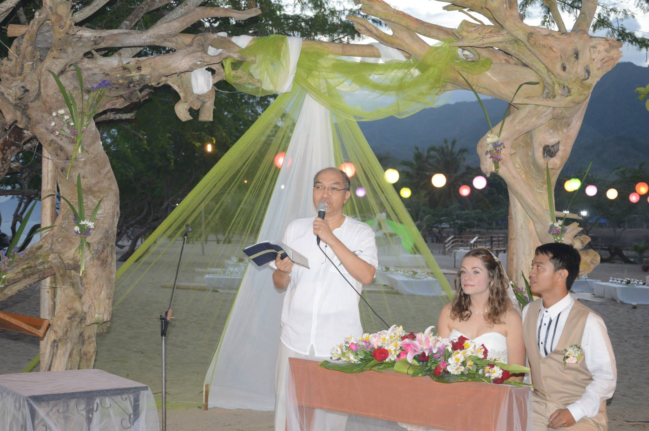

Slide 18
Crab and Shrimp Feast— my kind of a see food diet

Slide 19
A cake to die for—Mango Bravo

Slide 20
2016 West Loop Church Blessing
May God bless you to:
“Love your law” (Psalm 119:97), your t____, your in________, your te______, your w___ … beginning with Isaiah.
Declare, “How s____ are your w____ to my t____, s______ than h____ to my m_____!” (Psalm 119:103)

