Slide 1
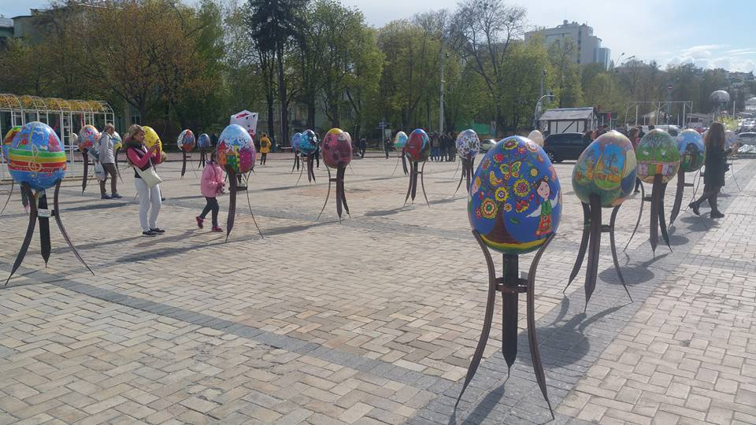
Podil-Kyiv Ukraine Report
Jan.- April 2017

Slide 2
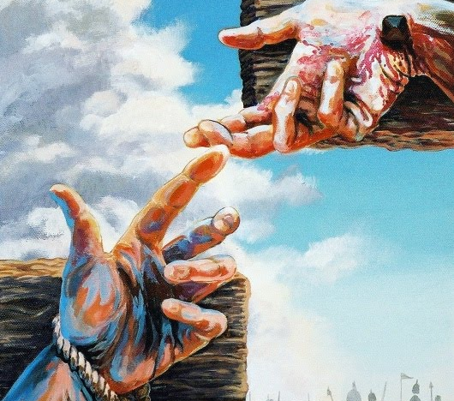
Jesus answered him, “Truly I tell you, today you will be with me in paradise.” Luke 23:43

Slide 3
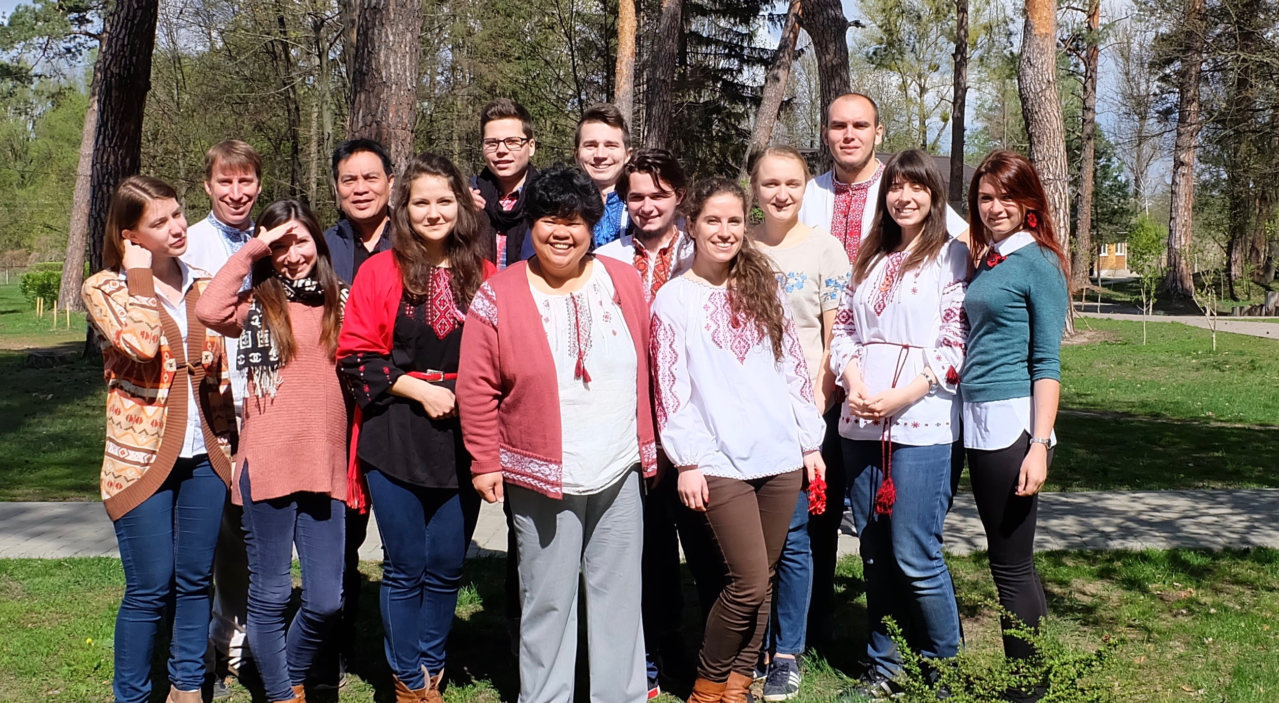
2017 Spring Conference

Slide 4

Lumen Christian Student Group

Slide 5
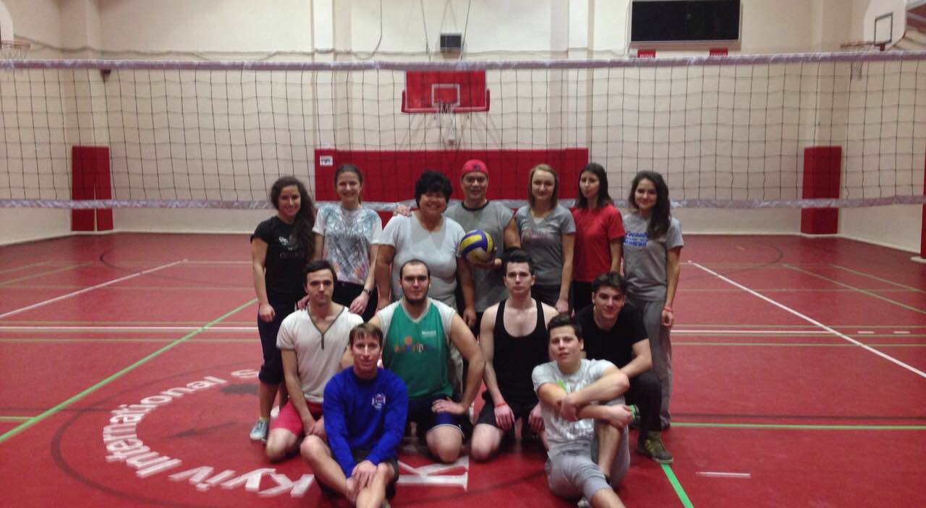
Volleyball and Basketball

Slide 6
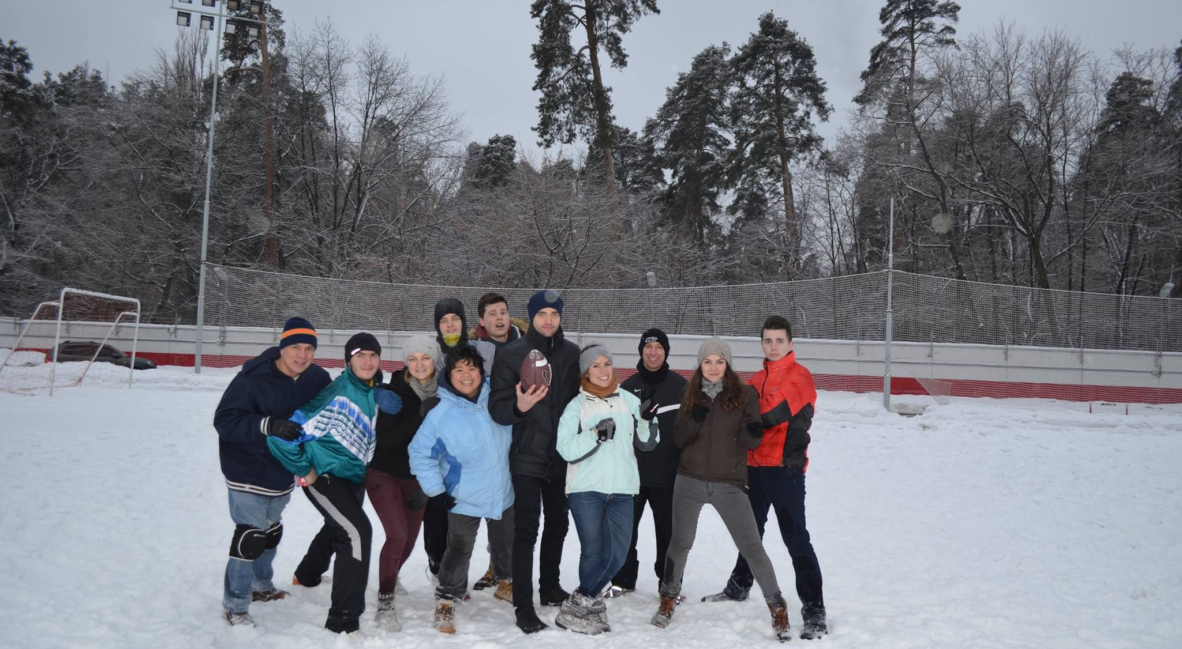
American Flag football

Slide 7
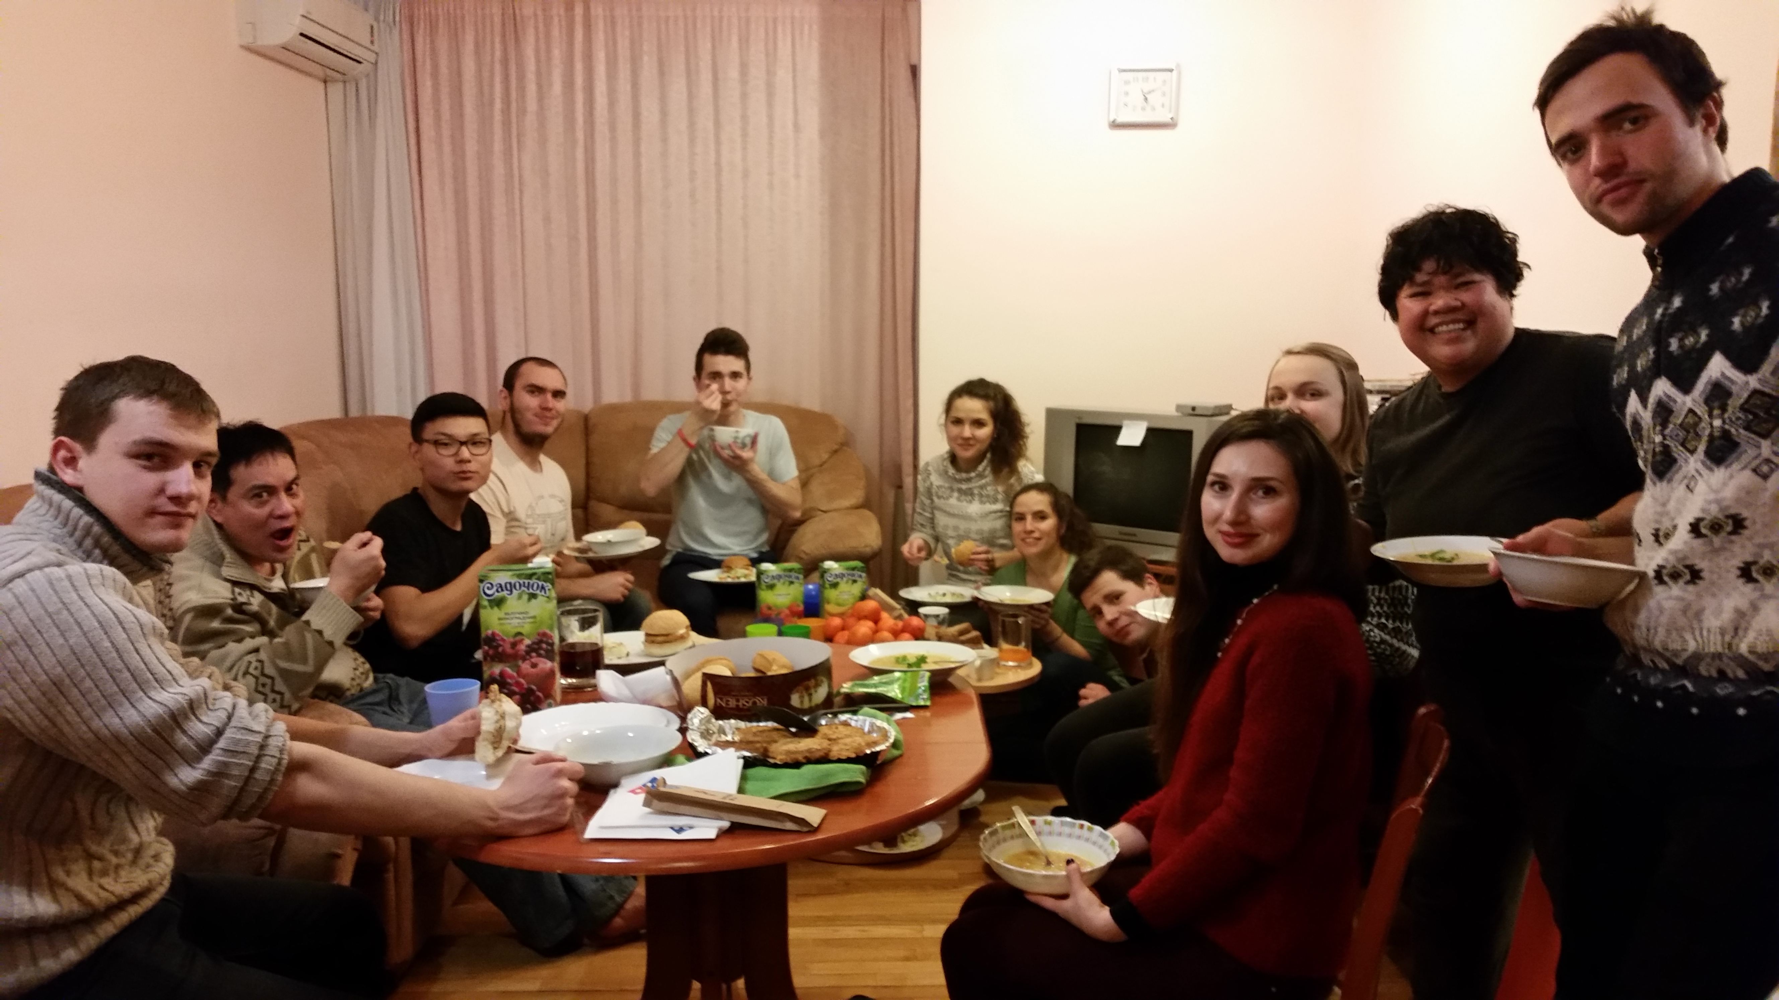
Dinner and Movie fellowship

Slide 8
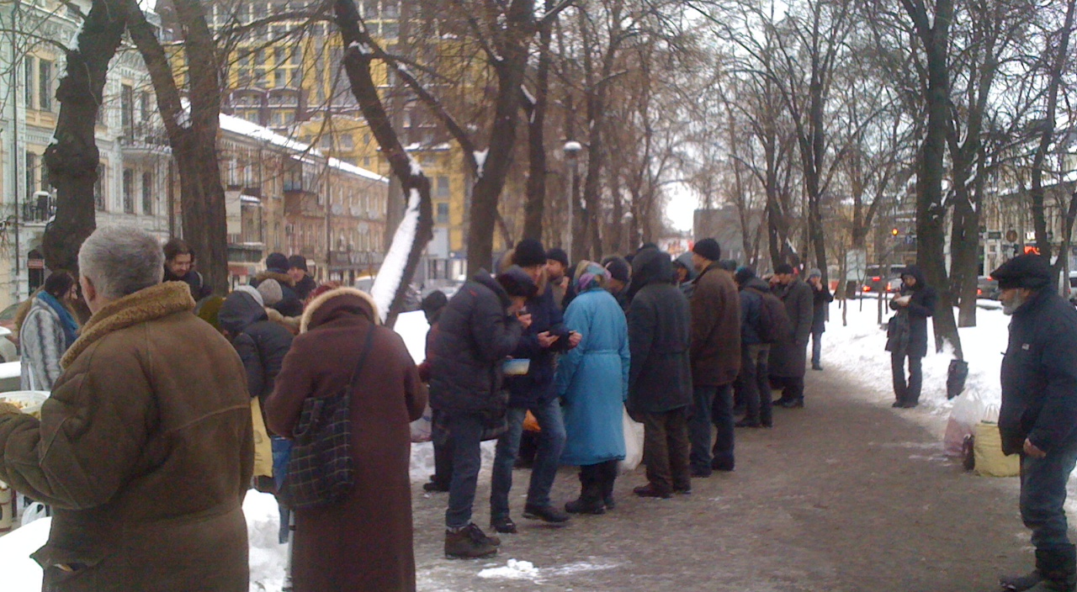
Feeding the homeless

Slide 9
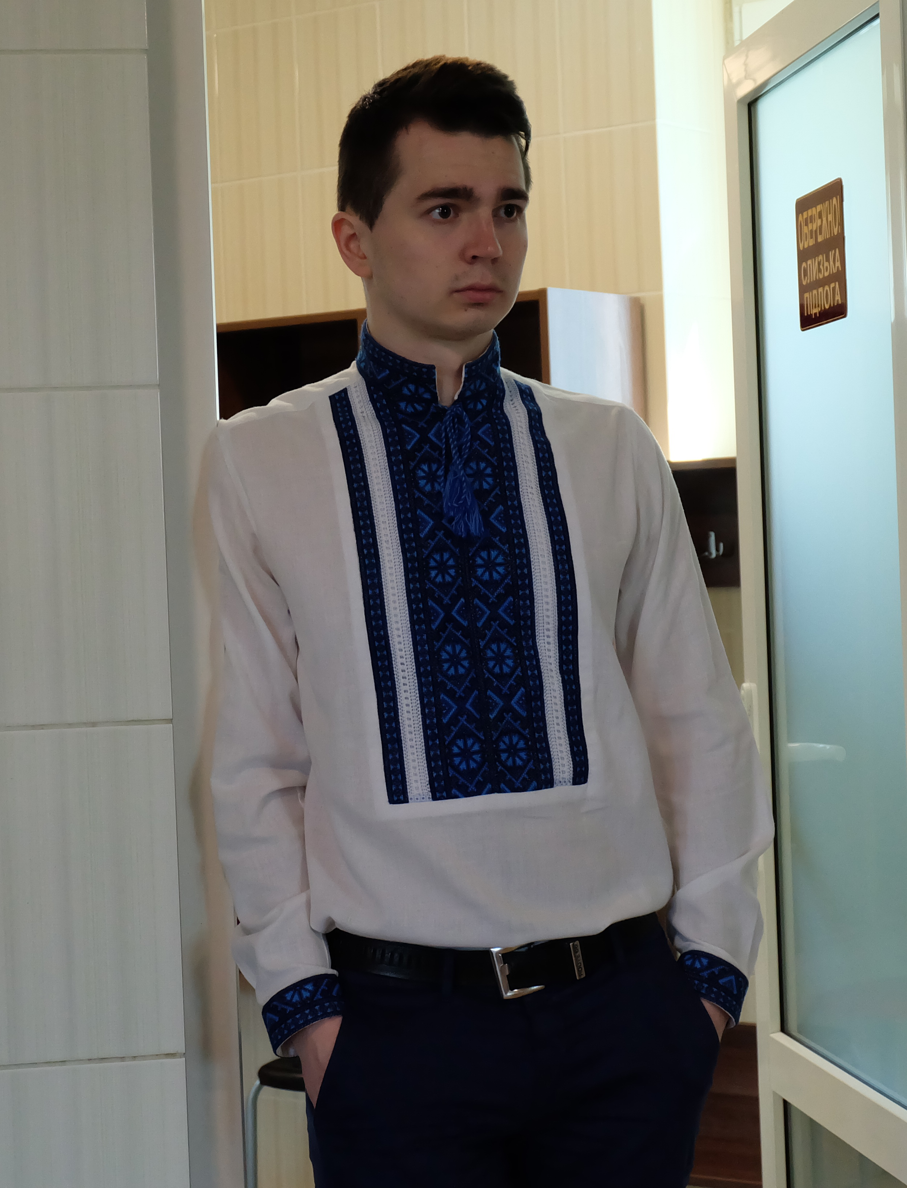
Roma

Slide 10
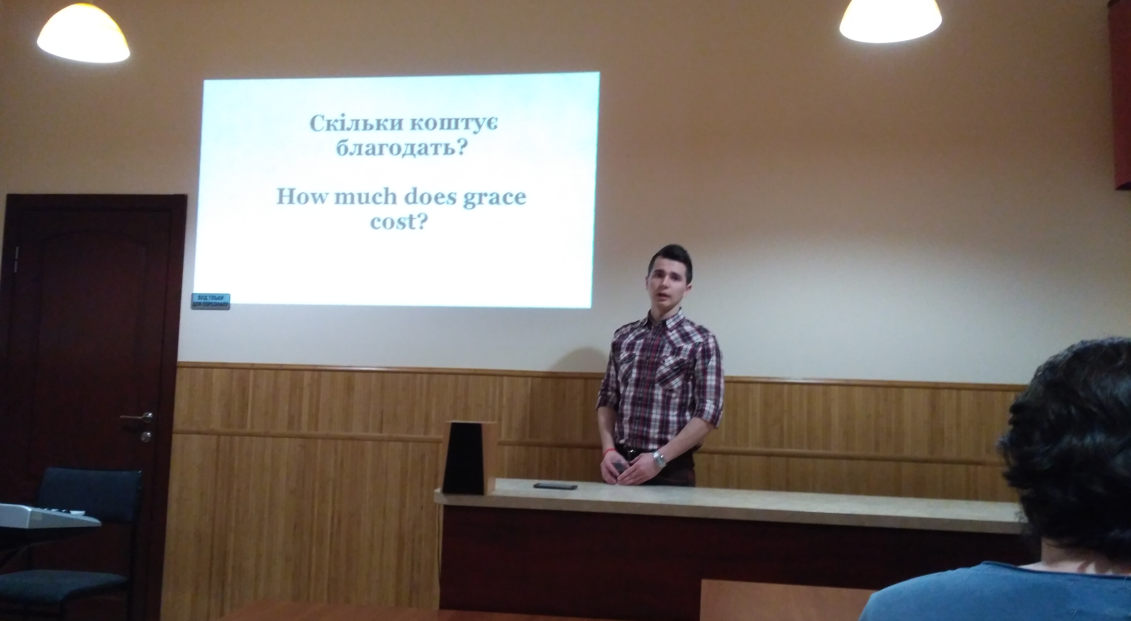
Roma Conference Messenger

Slide 11
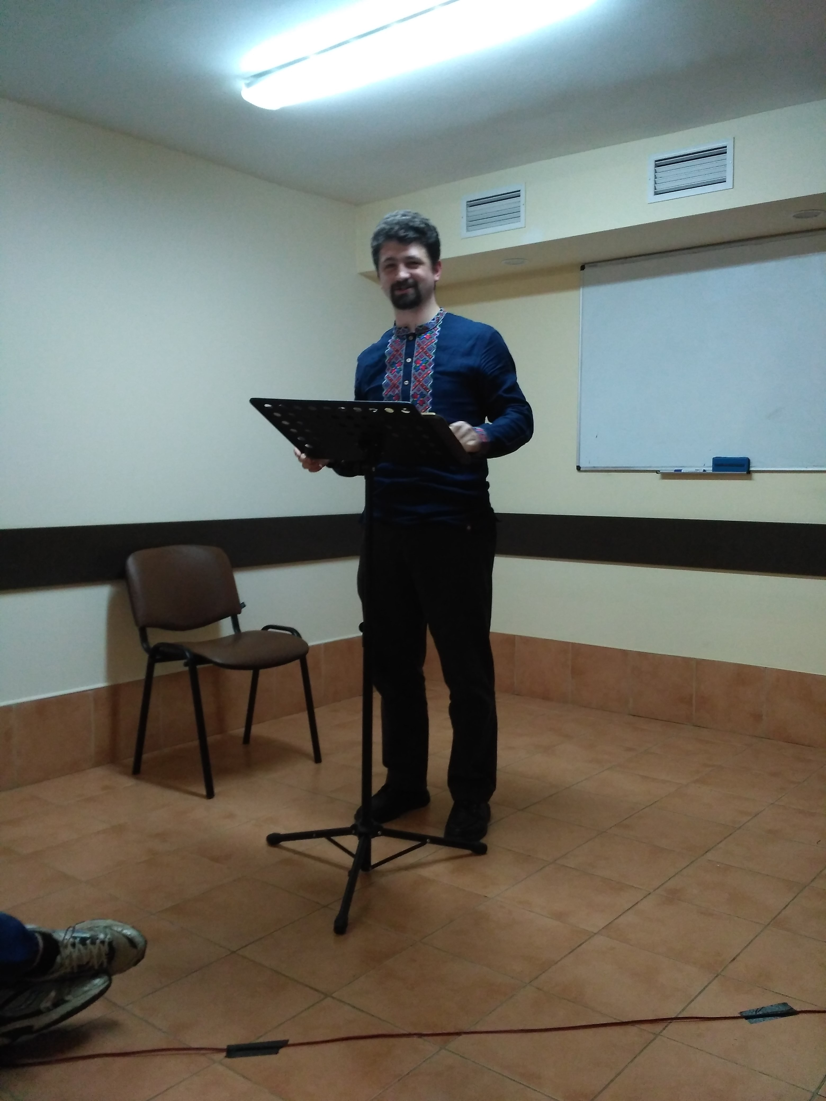
Jonathan Conference messenger

Slide 12
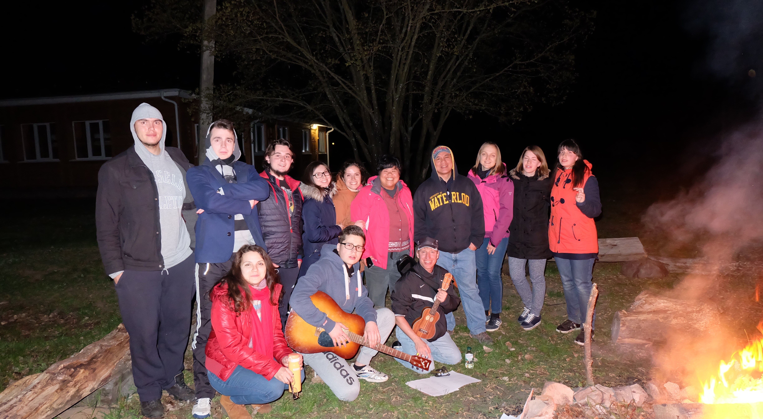
Campfire

Slide 13
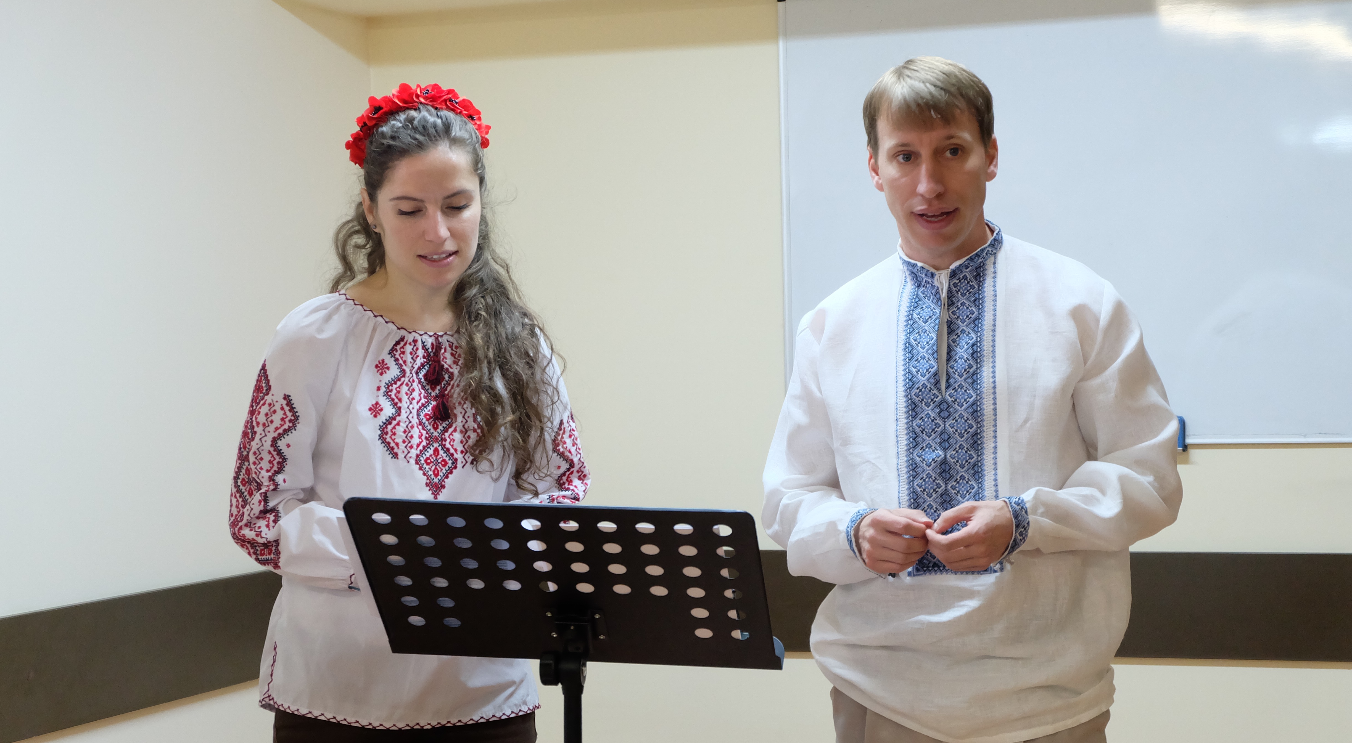
Rob Messenger, Nataliia translator

Slide 14
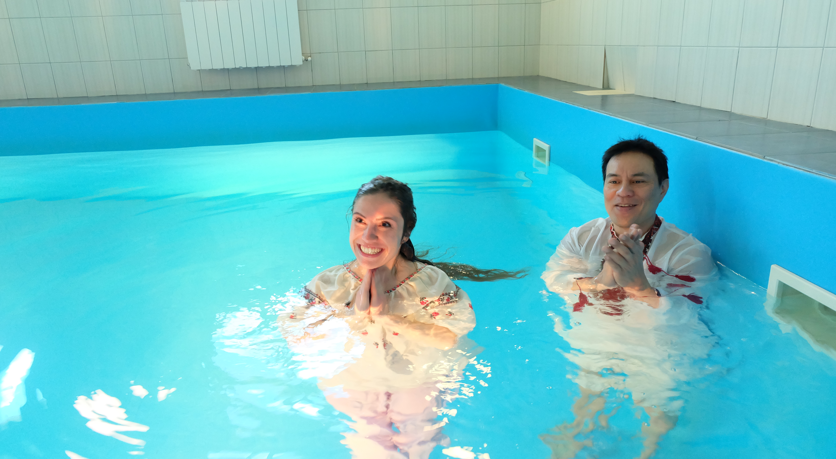
Natalia’s Baptism

Slide 15
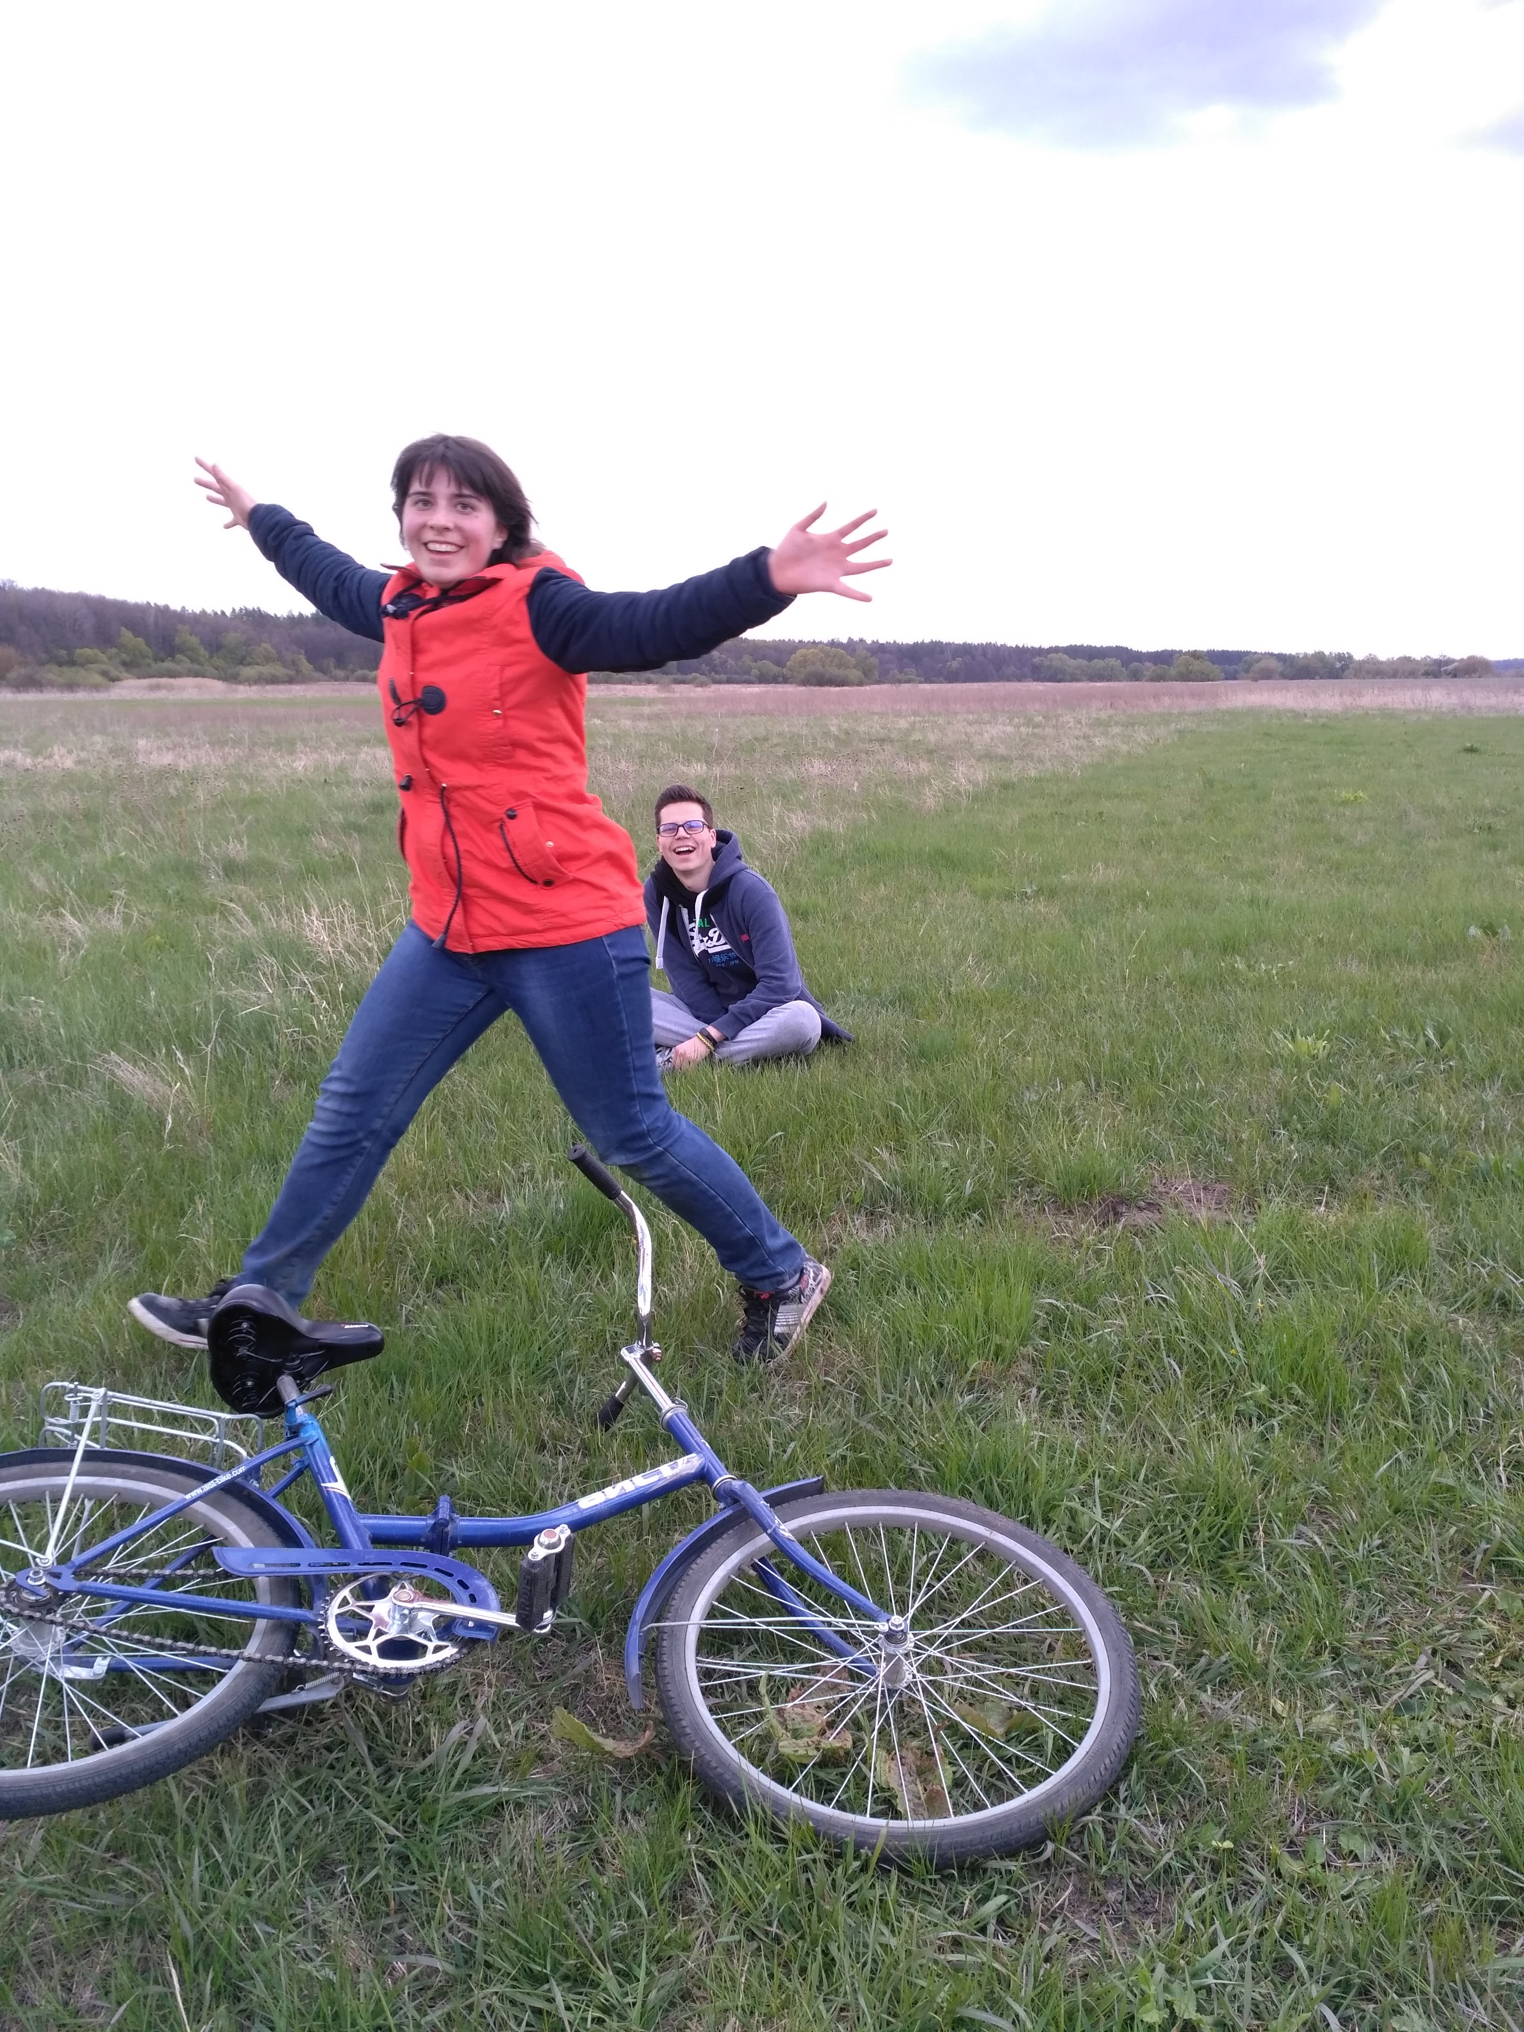
Jay

Slide 16
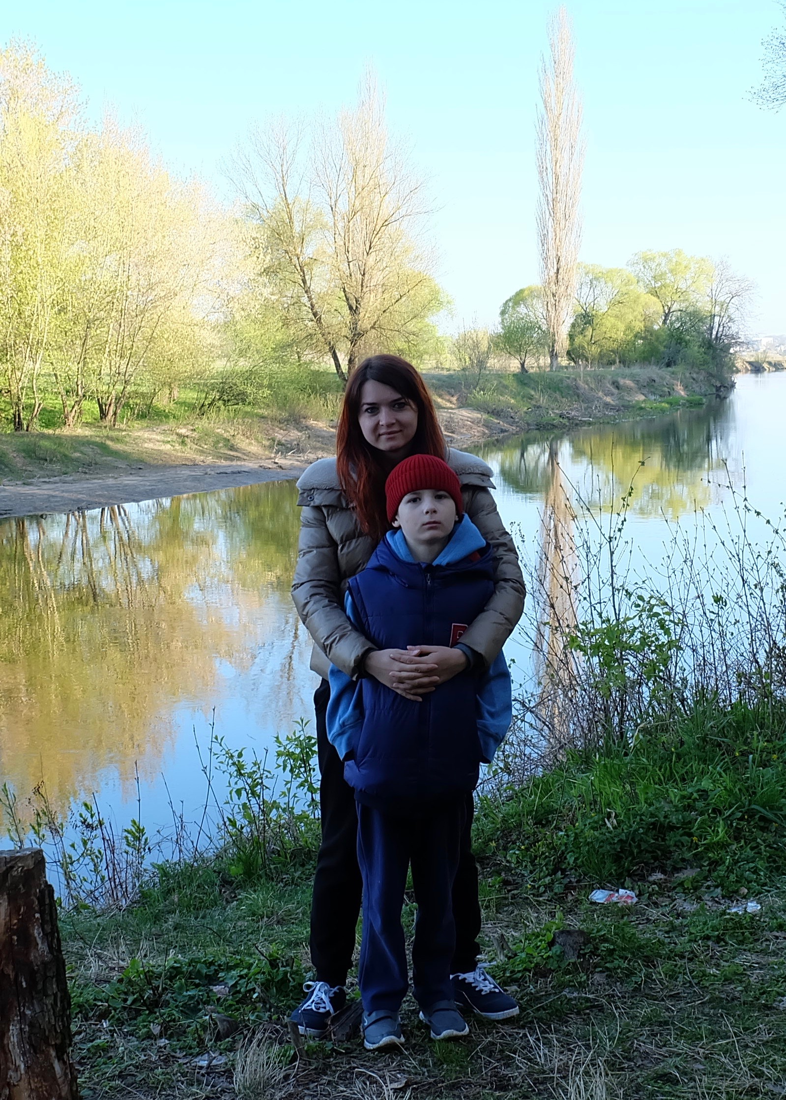
Katya

Slide 17
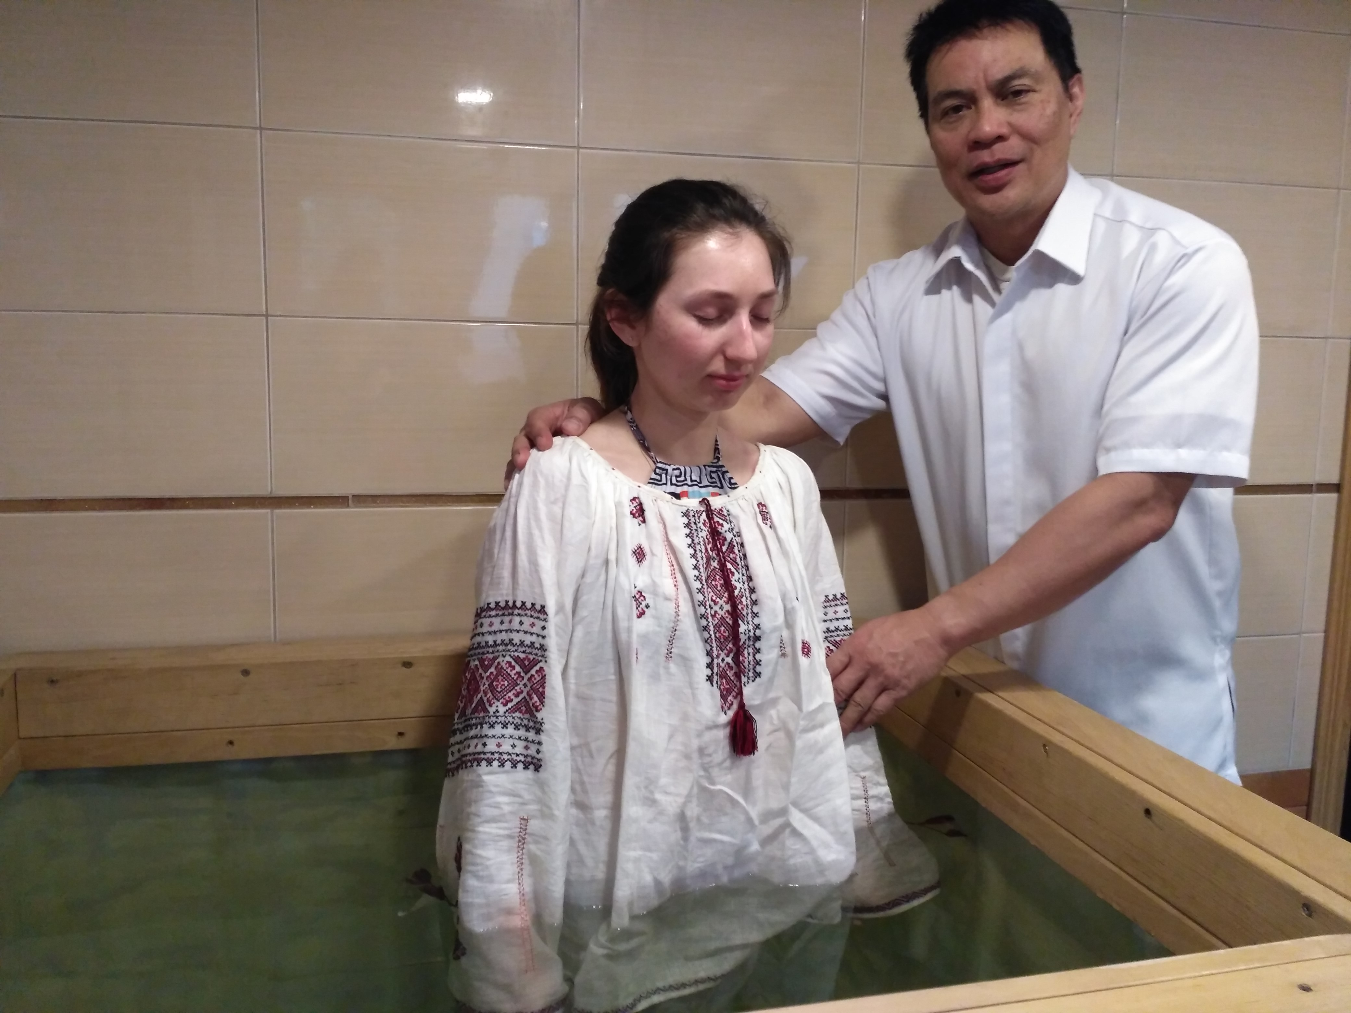
Yana’s Baptism

Slide 18
Prayer Topics
1. End the war in the Ukraine.
2. Raise up 12 Bible teachers.
3. Three families to be established
4. God bless the Bible Seminar with Dr. Mark Yang and Ron Ward.
5. Matthew Sunday Messages by John Peace

