Slide 1
Thailand UBF 2014
God did a new thing.
“See, I am doing a new thing! Now it springs up; do you not perceive it? I am making a way in the desert and streams in the wasteland.” (Isaiah 43:19)

Slide 2
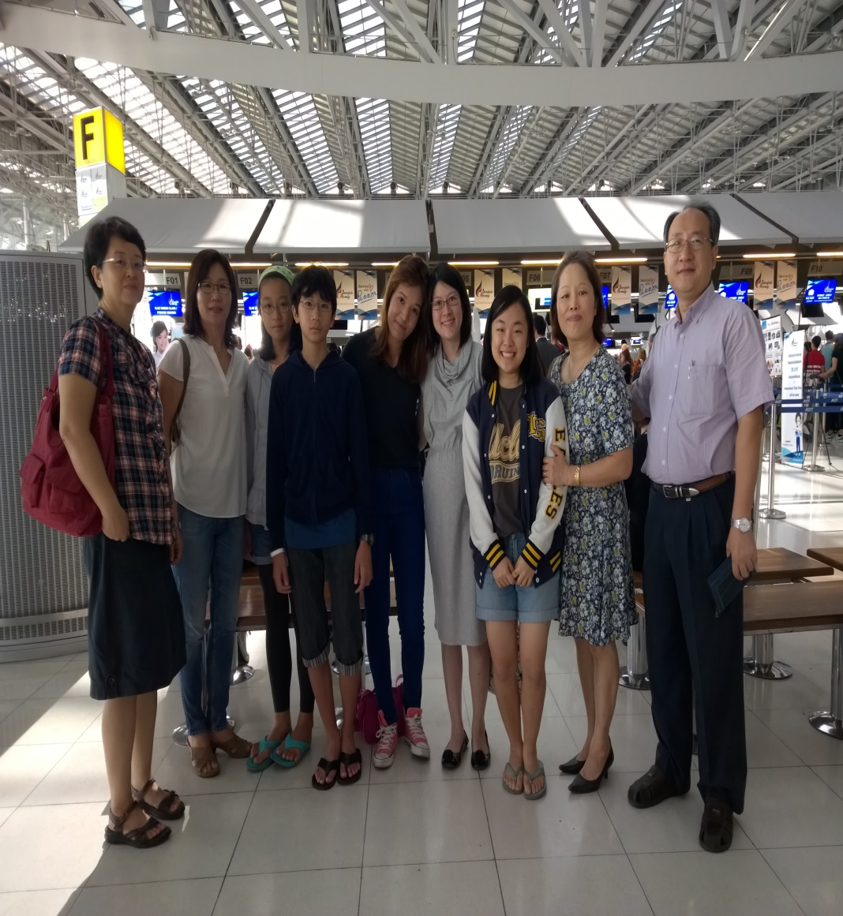
Sending Missionary Candidate to England

Slide 3
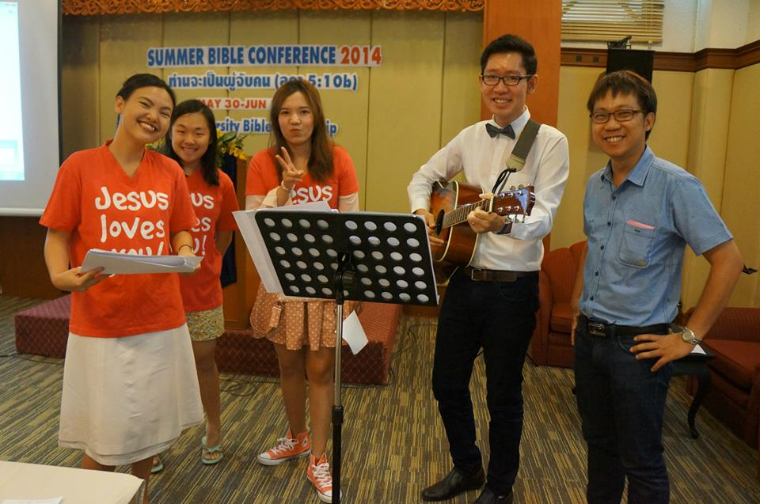
SBC (5.30~6.1)

Slide 4
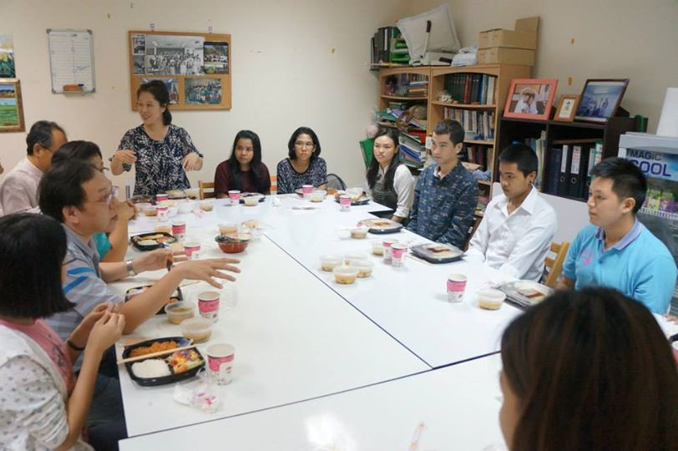
Mini Conference (10.25,26)

Slide 5
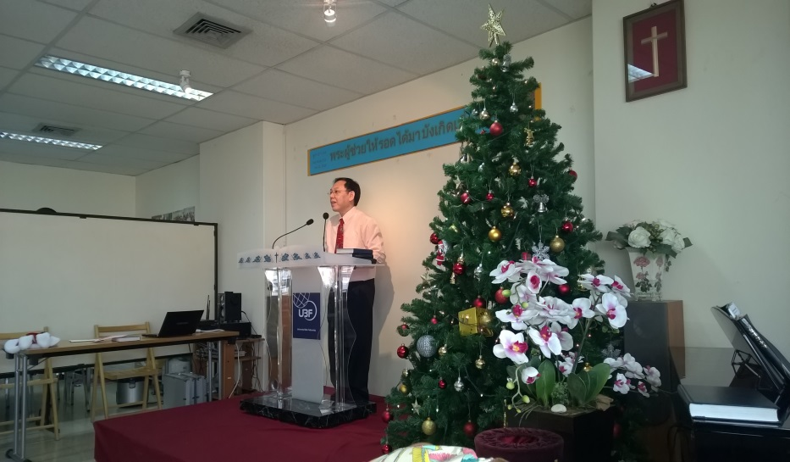
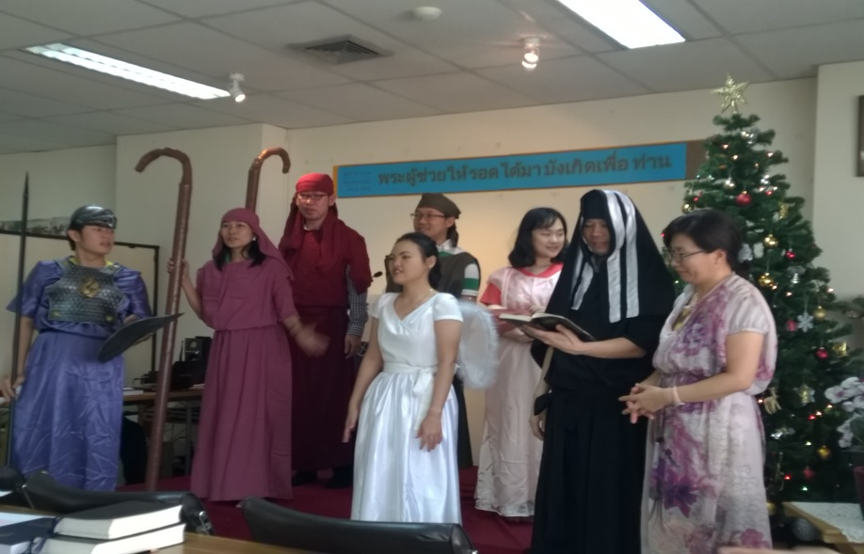
CWS(12.21)

Slide 6
Self-Supporting ministry

Slide 7
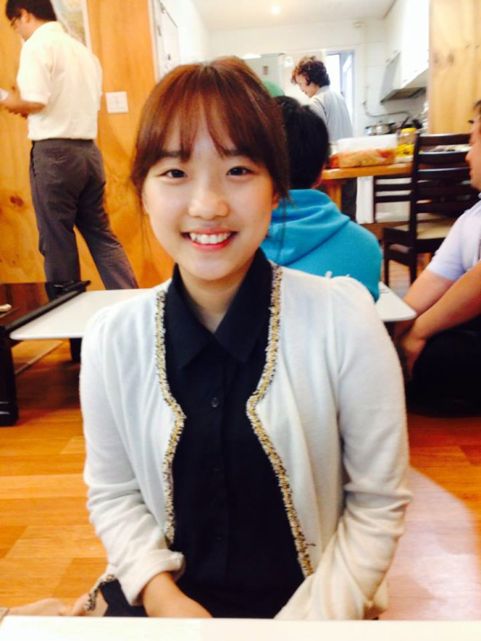
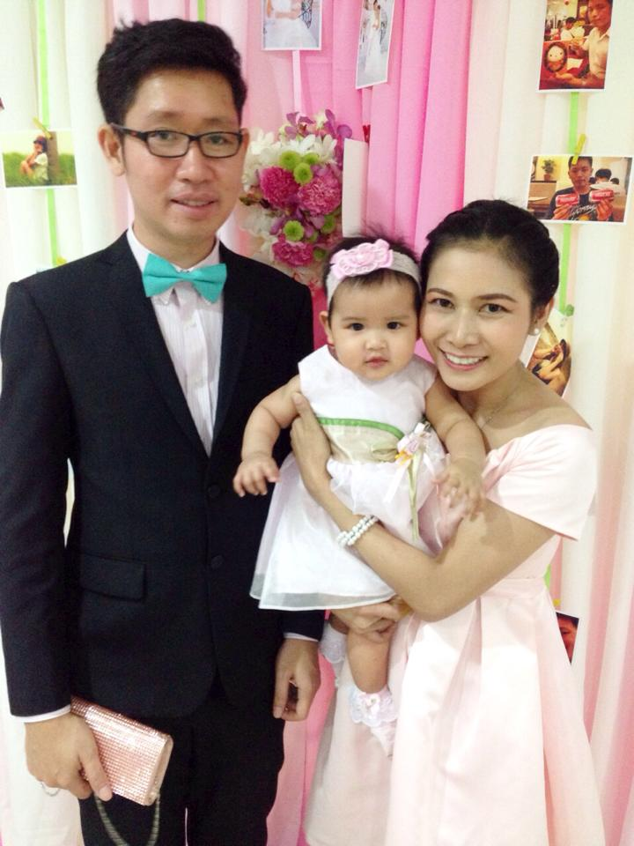
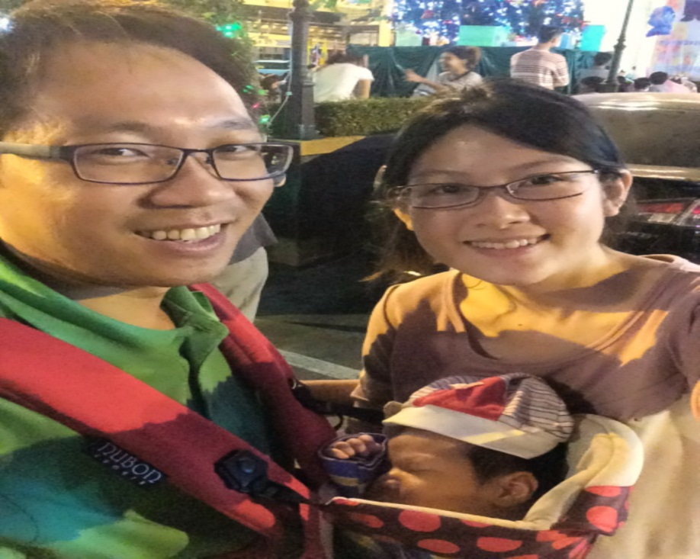
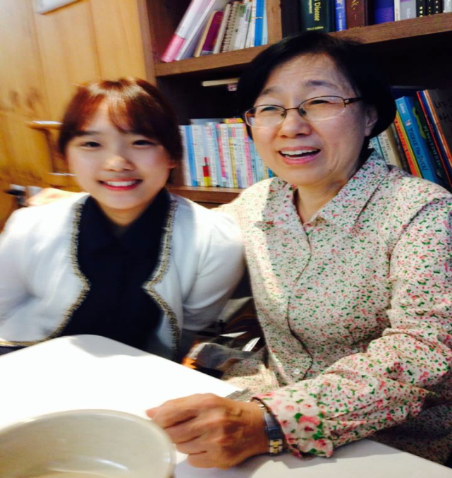
thanks giving topics 1

Slide 8
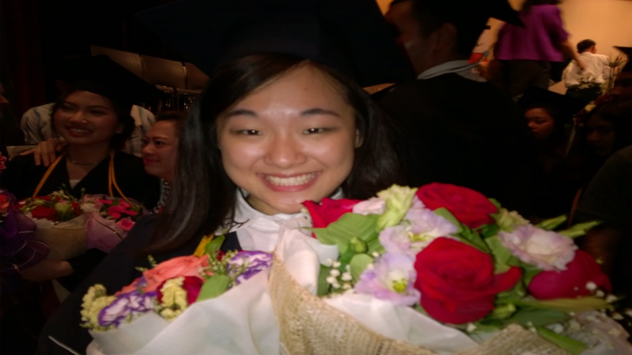
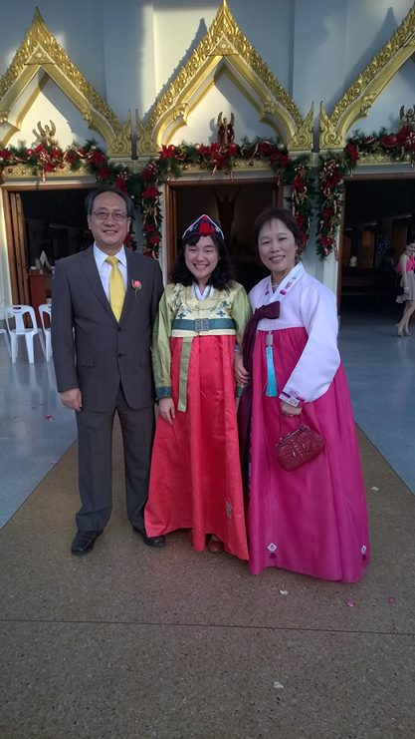
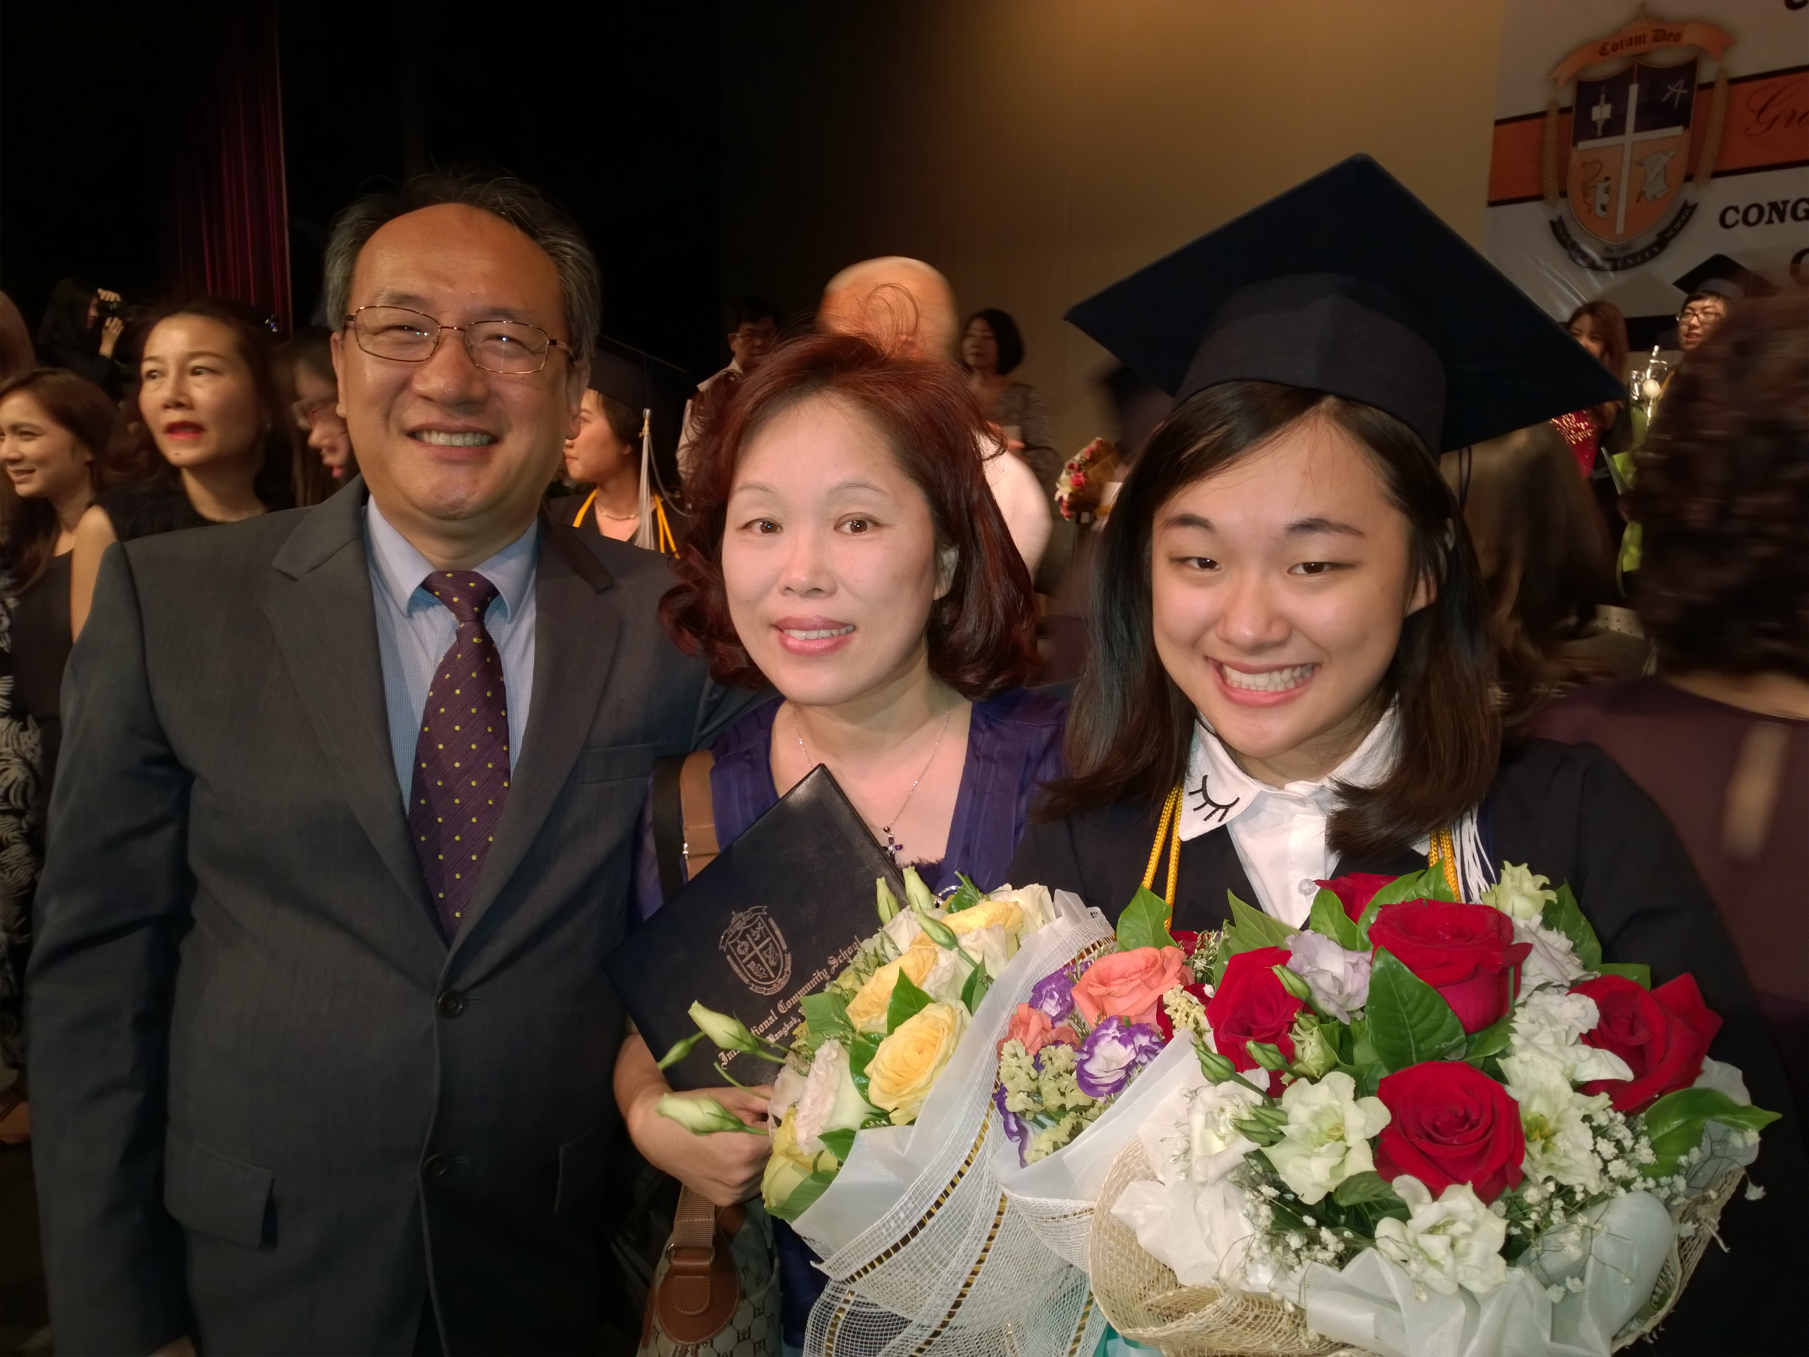
thanks giving topics 2

Slide 9
Welcoming 2015
Key Verse : “So do not fear, for I am with you; do not be dismayed, for I am your God. I will strengthen you and help you; I will uphold you with my righteous right hand.” (Isaiah 41:10)
Prayer Topics
1) Graceful and Powerful Mark Gospel message
2) 3 Fellowship doubling growth
3) Making brother sheep grow and become disciples
4) May Shep.Mongkol, Tam Paul and Luke grow as the servants of God’s Word and disciple makers.
5) Victory in business

