Slide 1
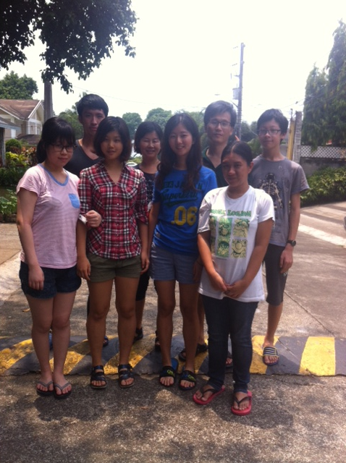
The Quezon chapter (UP quezon) in the Philippines
Bible conference on April 2014

Slide 2
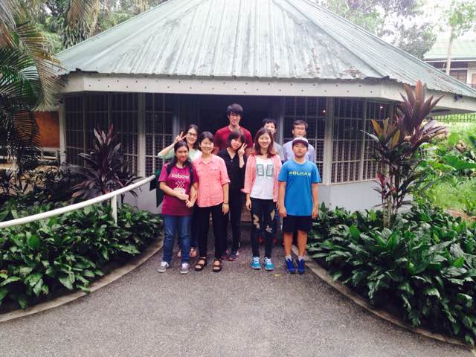
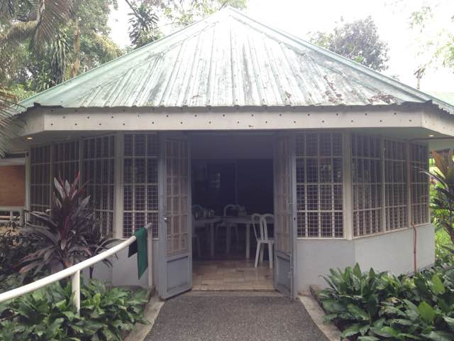
The Quezon chapter (UP quezon) in the Philippines
Worship service at new center in Campus on Nov 2014

Slide 3
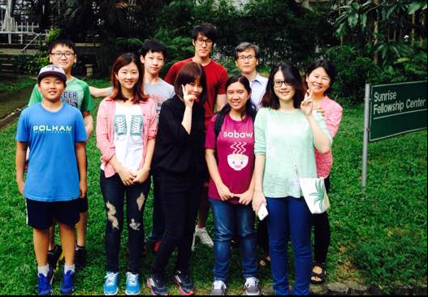
The Quezon chapter (UP quezon) in the Philippines
Worship service at new center in Campus

Slide 4
UP Los banos chapter in the Philippines
Msn Paul Ko service in UP campus

